Slide 1

(version 1.0)
Rian Quinn, quinnr@ainfosec.com
Brendan Kerrigan, kerriganb@ainfosec.com

Slide 2
Overview
Bareflank aims to provide all of the scaffolding needed to rapidly prototype new hypervisors in C++. Currently Bareflank has support for Linux on Intel 64bit CPUs, but support for Windows, OS X, and UEFI is coming as well as support for ARM and AMD platforms.

Slide 3
Outline
Motivation
C++ Environment
Bareflank Manager (BFM)
Drivers
VMM
Unit Tests
Extending the VMM
Future
Questions

Slide 4
Motivation
Too Focused On Virtual Machines
Hypervisors are used for more than virtualizing servers and running Windows on a Mac
In fact, there is a whole field of research where hypervisors are used without any guest virtual machines.
MoRE: https://github.com/ainfosec/MoRE
SimleVisor: https://github.com/ionescu007/SimpleVisor
HyperPlatform: https://github.com/tandasat/HyperPlatform
HyperBone: https://github.com/DarthTon/HyperBone

Slide 5
Motivation
Too Focused On Virtual Machines (continued)
Existing open source hypervisors focus too much on legacy support and guest virtual machines:
Xen: www.xenproject.org
KVM: http://www.linux-kvm.org/page/Main_Page
VirtualBox: https://www.virtualbox.org/wiki/Downloads
These hypervisors are painful to work with when conducting less traditional hypervisor research.
Thus researchers always start the same way, spending months standing up a hypervisor before working the actual project.

Slide 6
Motivation
Modularity
Existing hypervisors are both feature rich and static.
When adding new technologies to an existing open source hypervisor, in some cases, a lot of code must be removed as these projects contain a lot of capability that might get in the way.
Furthermore, these projects are not modular. Changes to these hypervisors requires a diff, which results in a painful, sometimes prohibitive update process.

Slide 7
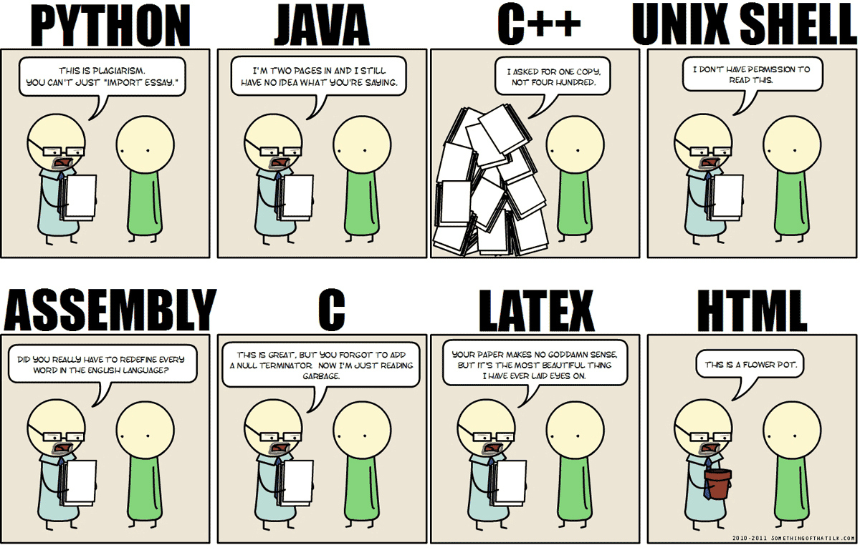
Motivation
Prototyping
Existing hypervisors don’t provide generic access to support libraries for fast prototyping (the never ending battle between C / C++)

Slide 8
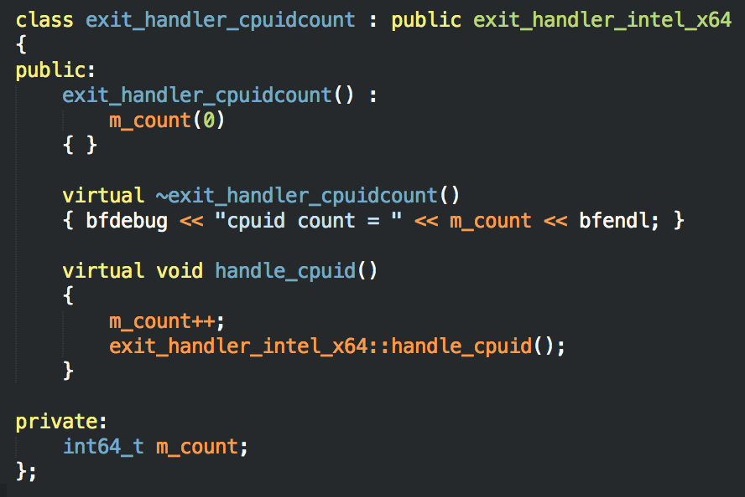
C++ Environment
Why C++
Using C++ inheritance, Bareflank provides a clear method for extending the base hypervisor to add additional functionality

Slide 9
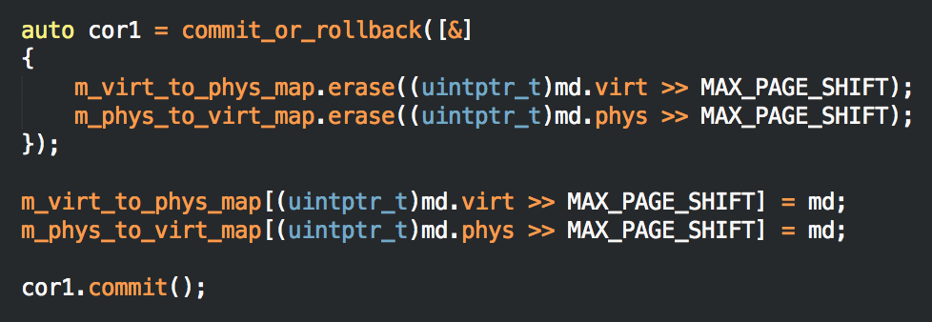
C++ Environment
Why C++
The C++ Standard Template Library (STL) provides Bareflank with generic library support for fast development and prototyping
In addition Resource Acquisition Is Initialization (RAII) provides for functionality like commit/rollback and mutex locker logic.

Slide 10
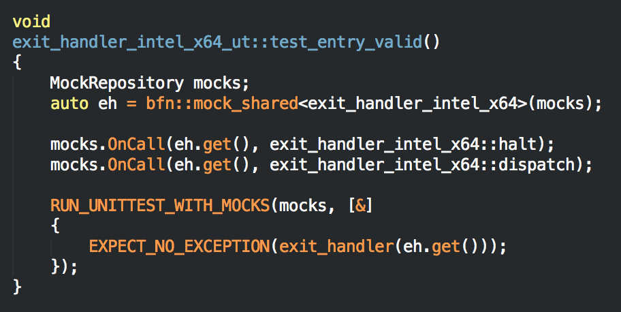
C++ Environment
Why C++
C++ has far superior unit testing frameworks than C. Bareflank uses Hippomocks (http://hippomocks.com)

Slide 11
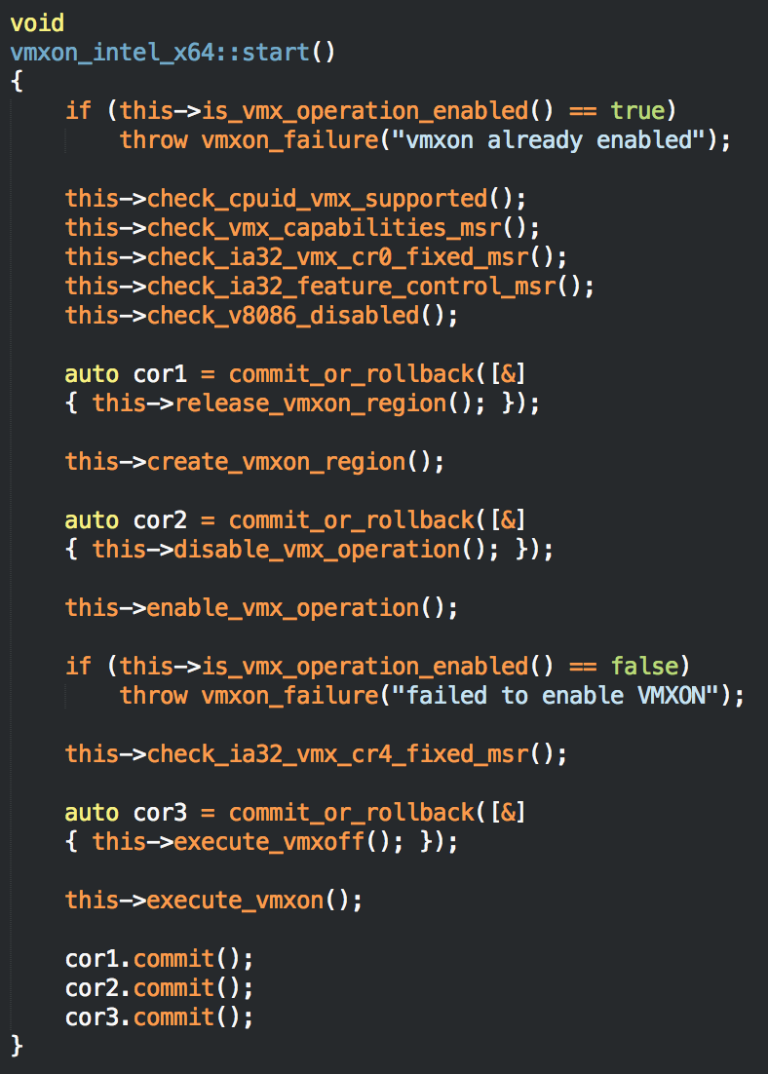
C++ Environment
Why C++
Hypervisors have to deal with a lot of error checking / handling
C++ exception support greatly simplifies this process and results in easier to read code
Notes:
This is the code to enable VMXON, a process that is well documented in the Intel Manual. As shown, this code reads like the manual. Without exceptions, each one of these functions would have to be checked for errors and handled properly. In addition, RAII removes the need for complex goto statements to unravel state changes should an error occur.

Slide 12
C++ Environment
High Level Architecture
BFM (user-space application) communicates with the drivers to start/stop hypervisor
Drivers use the custom ELF loader to load the VMM modules
Each module’s C runtime is executed by the driver to execute global constructors / destructors and register exception handling information
Kernel safe unwind library provides exception support

Slide 13
C++ Environment
Cross Compiler Script
The Bareflank hypervisor is compiled using a cross compiler (TARGET=x86_64-elf)
To create this cross compiler, Bareflank contains two scripts:
setup-<platform>.sh
create-cross-compiler.sh
The setup script is specific to the OS your using, and installs the packages needed to create the cross compiler.
The create script actually creates the cross compiler and it’s system root (sysroot)

Slide 14
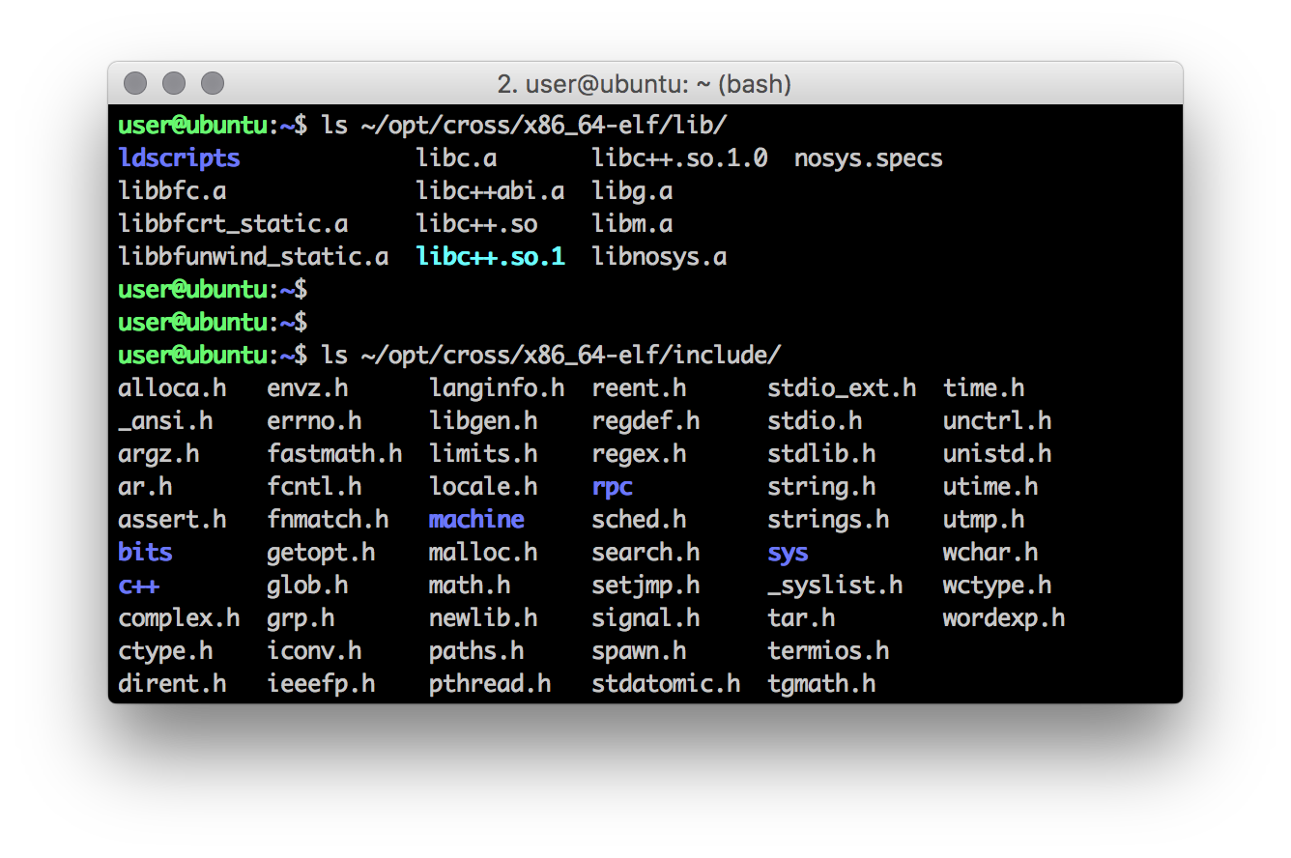
C++ Environment
Cross Compiler Script
The sysroot contains all of the headers / libraries needed to bootstrap libc++

Slide 15
C++ Environment
Cross Compiler Script
When the create script is finished, it cleans itself up, removing it’s temporary build environment. If you wish to make changes, setting KEEP_TMP=true in your shell will prevent the script from performing said cleanup
Each step the script takes generates a “completed_xxx” file in the build environment. Remove one of these files and rerun the script to rerun a specific step.

Slide 16
C++ Environment
Cross Compiler Script
The setup scripts limit which operating systems can be used to only the supported ones. If you wish to use an unsupported OS, feel free to modify these scripts or create your own and give it a shot.
The create script currently has to main limitations:
It expects the resulting cross compiler to be placed in ~/opt/cross. This limitation will be removed in future versions.
This script currently only supports a GCC cross compiler. Clang / LLVM support will be added in future releases.

Slide 17
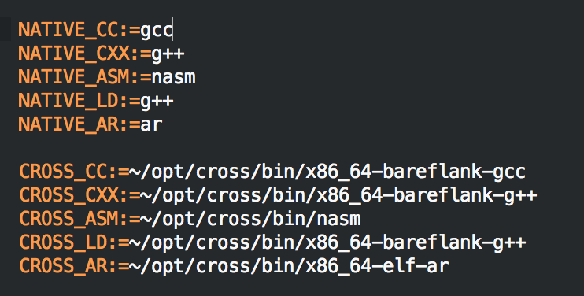
C++ Environment
Build System
The build system compiles most of the source code using both the system’s native compiler, and the cross compiler
The native compiler is used for BFM and unit tests, while the cross compiler is used for the VMM.

Slide 18
C++ Environment
Build System
The main three flags that Bareflank uses (and will continue to need) are: -fpic, -ffreestanding and -mno-red-zone
In particular, -mno-red-zone prevents an issue with the System V spec that causes stack corruption in the kernel (real joy to track down )
http://eli.thegreenplace.net/2011/09/06/stack-frame-layout-on-x86-64/
http://wiki.osdev.org/Why_do_I_need_a_Cross_Compiler%3F#-mno-red-zone_.28x86_64_only.29

Slide 19
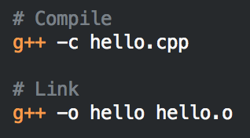
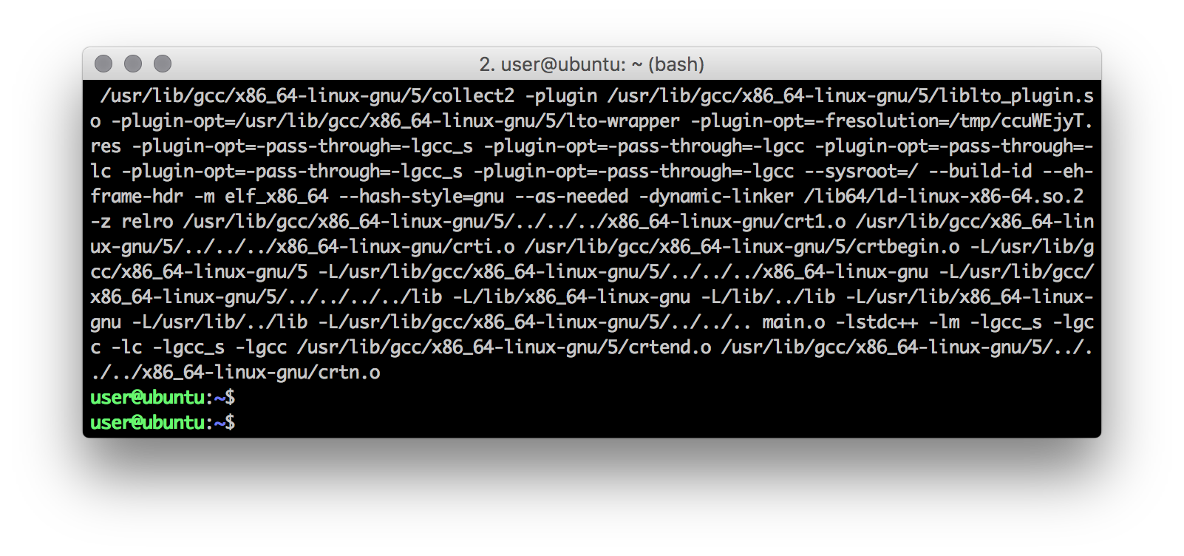
C++ Environment
Wrapper Script
When compiling and linking a program, you typically invoke the compiler twice. Once to compile the code, and once to link the compiled object files.
Under the hood GCC does this for you:

Slide 20

C++ Environment
Wrapper Script
The extra args are object / header files specific to your OS that are needed to link a program such that it can be run by your OS
Since Bareflank provides it’s own C runtime library and ELF loader, we were left with three possible options:
Patch GCC and Clang to provide the linker args as we need them (for every version of GCC and Clang we decide to support)
Run LD manually (ideal solution)
Create bash wrapper script for GCC/Clang that acts like GCC/Clang, but runs LD manually during linking

Slide 21
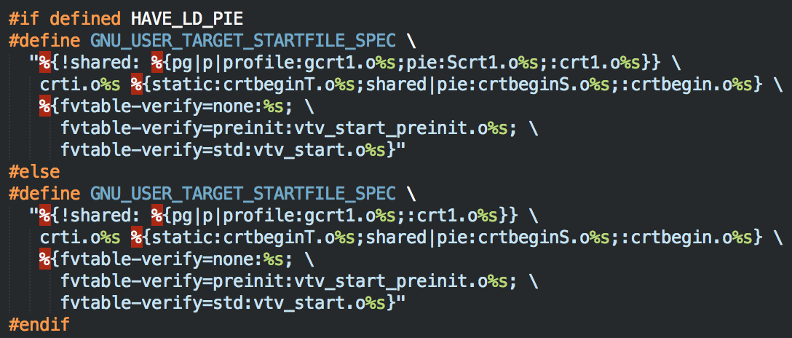
C++ Environment
Wrapper Script
Patching GCC would involve managing code like this for every version of GCC (not to mention Clang):
http://wiki.osdev.org/OS_Specific_Toolchain

Slide 22

C++ Environment
Wrapper Script
Seriously?

Slide 23
C++ Environment
Wrapper Script
Running LD manually was what we did at first until it came time to compile Libc++ which uses CMake.
CMake expects that you are using the compiler as the linker. In other words, CMake does not have a clean set of variables for the linker like it does for the compiler such as:
CMAKE_C_COMPILER
CMAKE_CXX_COMPILER
https://cmake.org/pipermail/cmake/2014-August/058268.html
One week later, we moved to option #3

Slide 24

C++ Environment
Wrapper Script
Really?
One week later, we moved to option #3

Slide 25
C++ Environment
Wrapper Script
Bareflank uses a bash script that mimics GCC (and eventually Clang). If “-c” is provided GCC/G++ is used, and LD is used otherwise.
No patches are needed to GCC or Clang, meaning Bareflank’s build environment works (so far) on all of the cross compilers we support without modifications (GCC 5.1, 5.2, 5.3 and 6.1)
Object files and header include paths are added to GCC/G++ and LD as needed
Ugly hacks are contained in one, easy to script place

Slide 26
C++ Environment
Libc++
With regards to the C++ STL, there are not many options (which we found surprising).
The two biggest libraries are Libc++ and Libstdc++
There are several other more esoteric implementations that have either been abandoned, or do not support C++11/C++14
Libstdc++ / libsupc++ (GNU’s library set) are almost impossible to build when not targeting a specific OS.
http://wiki.osdev.org/Talk:Libsupcxx

Slide 27
C++ Environment
Libc++
Libc++ / libc++abi (Apple’s C++ library set) on the other hand was:
Easy to compile (once we created the wrapper script)
Supports C++11 / C++14 and most of C++17
Can be compiled with and without threading support
Can be compiled with and without exception support
Works well with both GCC and Clang/LLVM
Supports the Newlib C library

Slide 28

C++ Environment
Libc++
Sadly libc++ / libc++abi are not perfect:
Some functions make heavy use of the stack. This is fine for sane operating systems like Windows and OSX, but Linux only has an 8k stack by default which causes issues.
Some functions (like the unordered_map hash function) use floating point arithmetic which is not supported in the kernel
Some functions use divide / modulo which is also not supported in the kernel
For these reasons, future versions of Bareflank will patch Libc++ to cleanup needed functionality

Slide 29
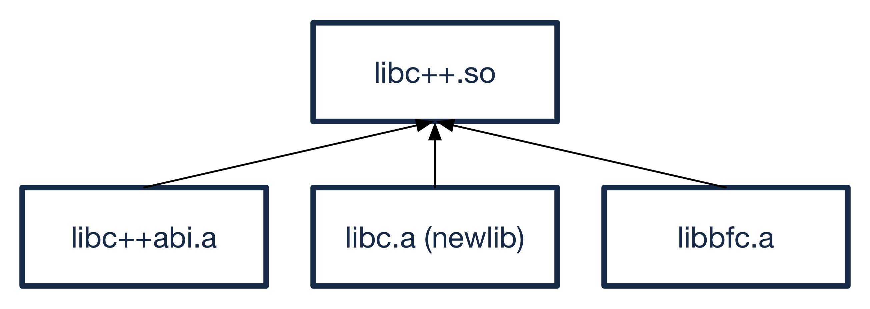
C++ Environment
Libc++ Structure
Bareflank loads a library called libc++.so to get it’s C++ functionality.
This library actually consists of libc++, libc++abi, newlib and libbfc all compiled into a single shared library.

Slide 30
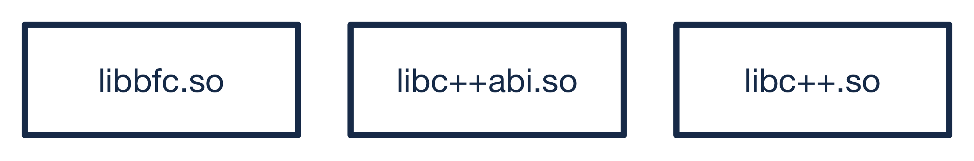
C++ Environment
Libc++ Structure
The problem with this approach is some symbols are missing from libc++abi as it is statically linked.
To solve this, future versions of Bareflank will provide it’s own libc which will enable libc, libc++ and libc++abi to all be loaded as individual shared libraries

Slide 31
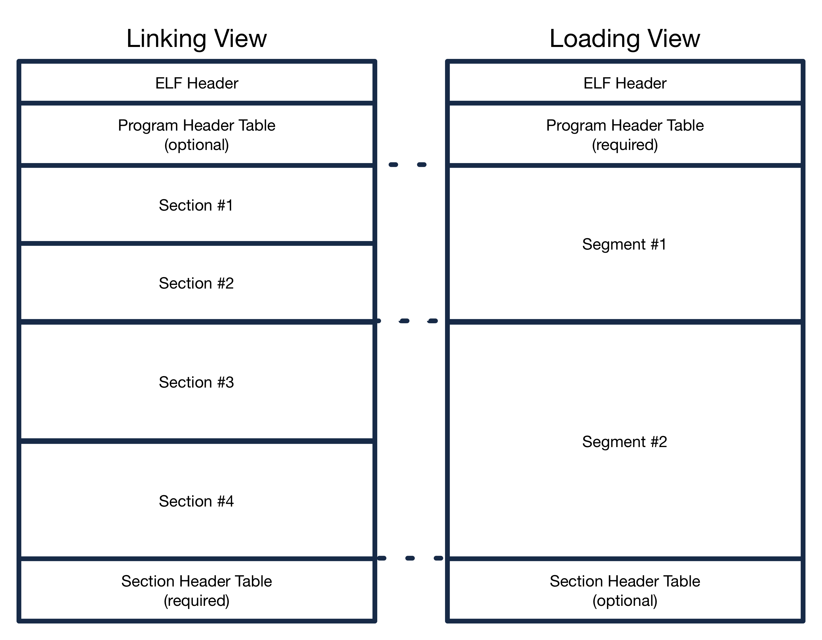
C++ Environment
ELF Loader
Bareflank comes with a custom ELF loader to load the VMM into the running kernel

Slide 32
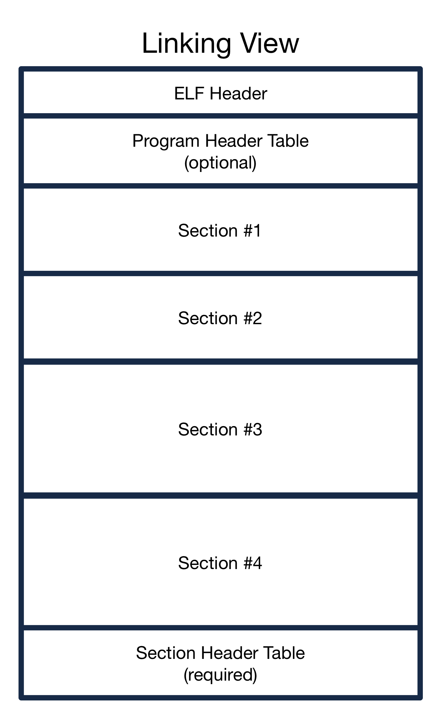
C++ Environment
ELF Loader
Each ELF file is divided into a set of “sections”.
Each section provides different resources that are needed to execute the code in the ELF file
Examples include:
.text
.data
.dynamic
.ctors/.dtors
.eh_frame

Slide 33
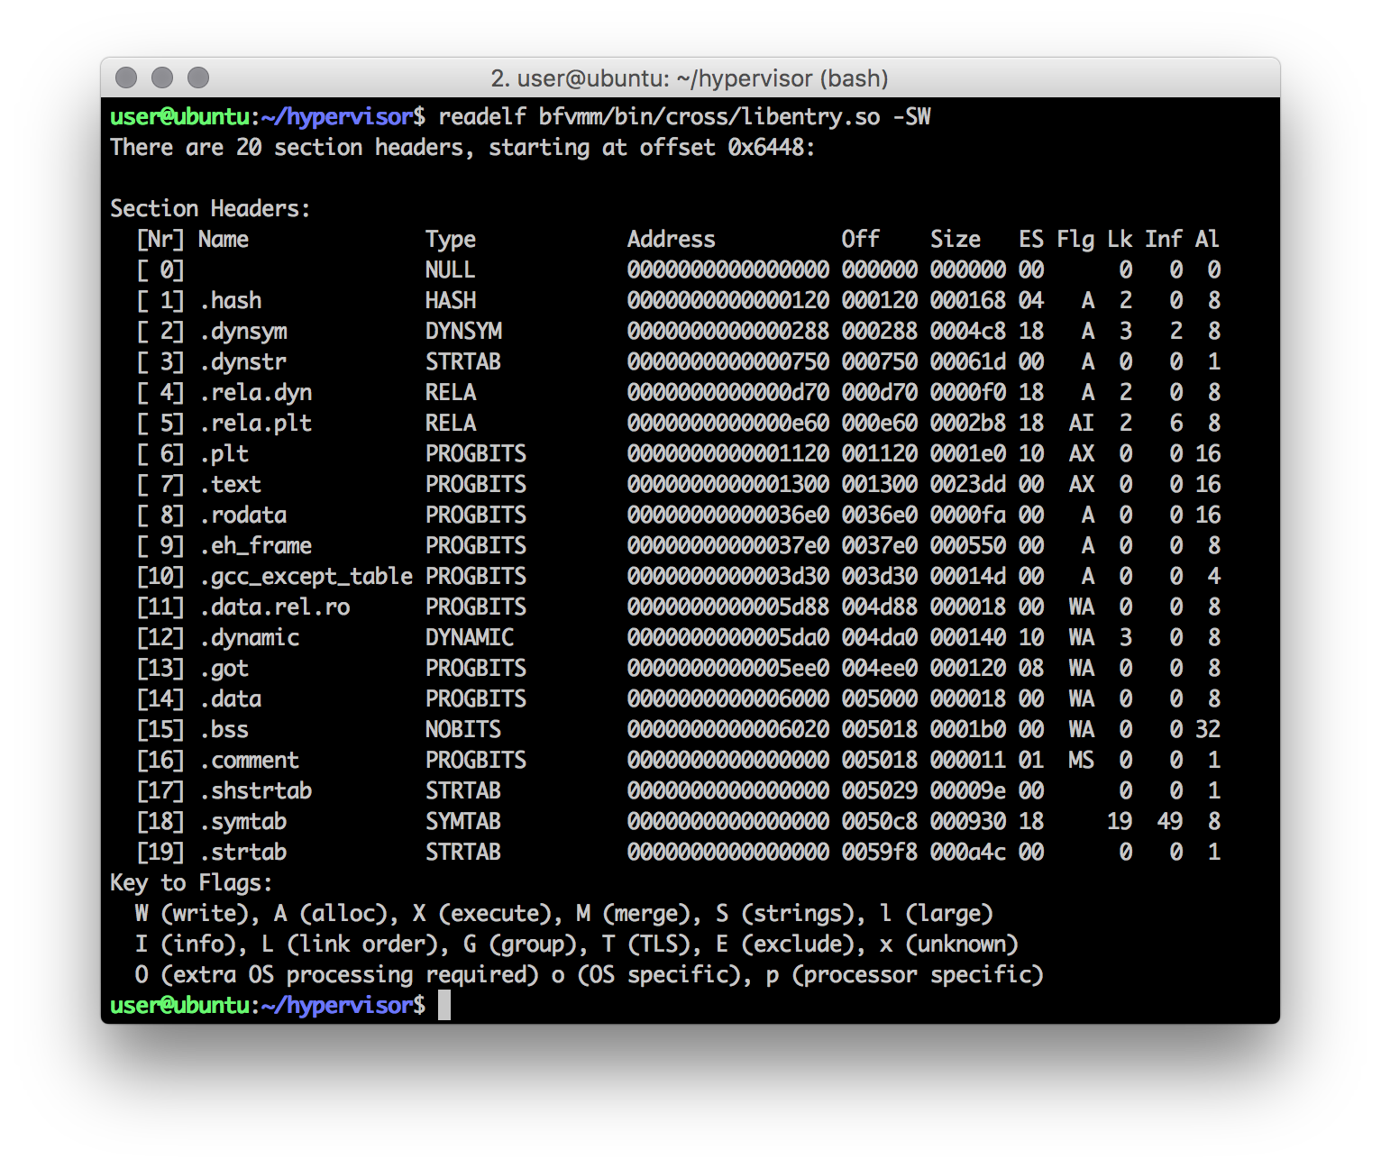
C++ Environment
ELF Loader

Slide 34
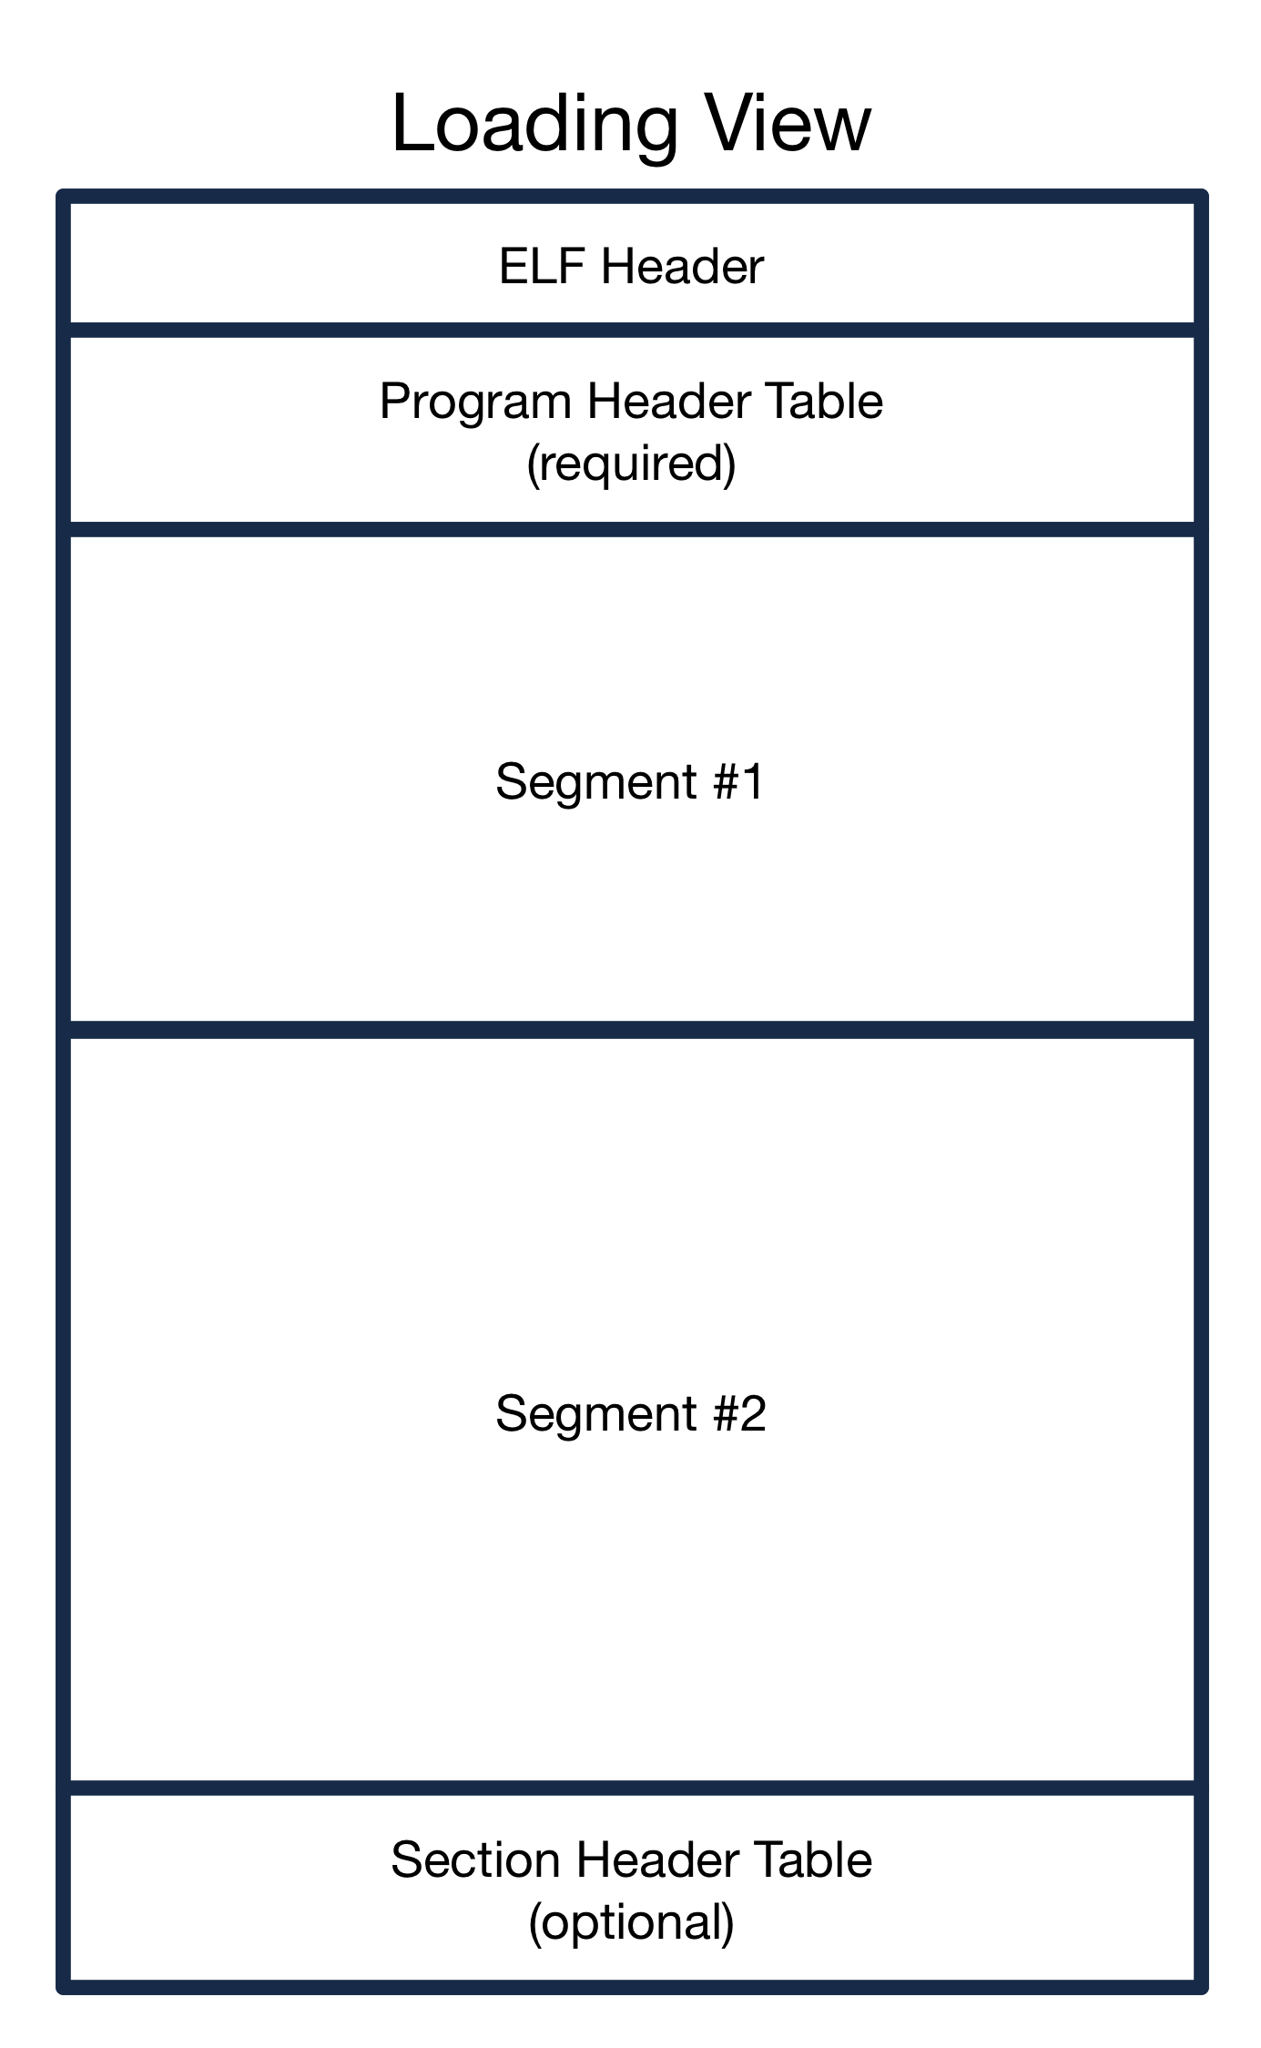
C++ Environment
ELF Loader
In an ELF file, all of the sections are grouped into “segments” (also called program headers)
Each segment provides the ELF loader with instructions as to where to load the segment as well as what type of memory to load the segment into
For Bareflank, all of the modules have a ”R/W” and a “R/E” segment

Slide 35
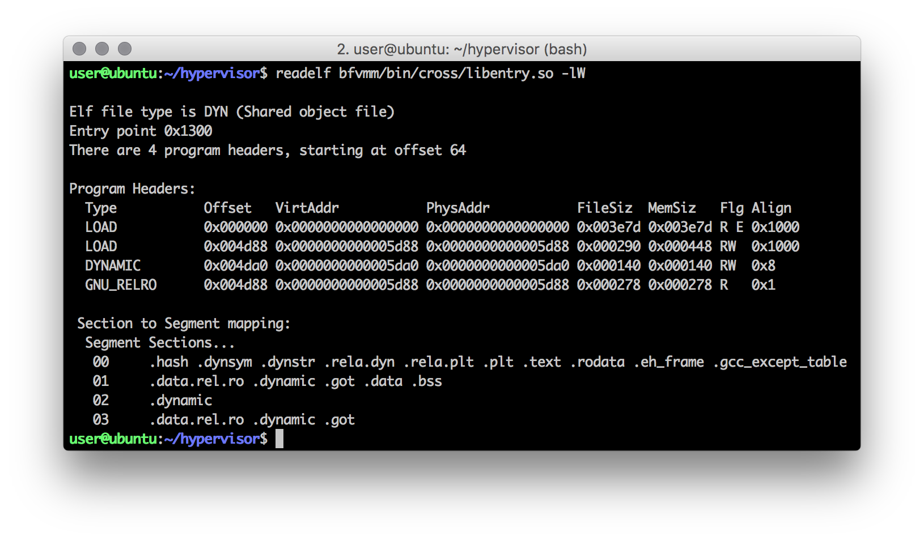
C++ Environment
ELF Loader

Slide 36
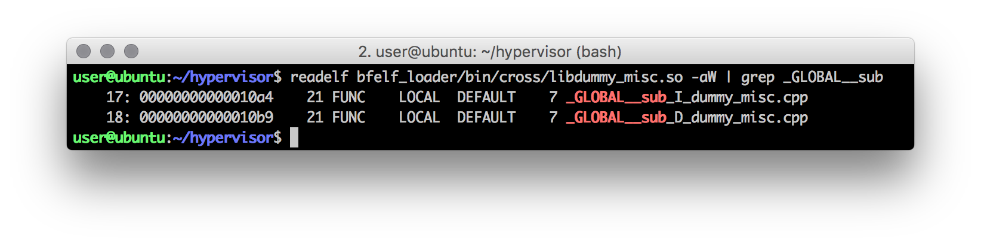
C++ Environment
ELF Loader
To handle global constructor / destructors, each ELF file (that needs it) has a .ctor / .dtor section, or in the case of Clang / LLVM, a .init_array / .fini_array
These sections contain a table of void (*func)(void) functions. In most cases, only one function is present in each:

Slide 37
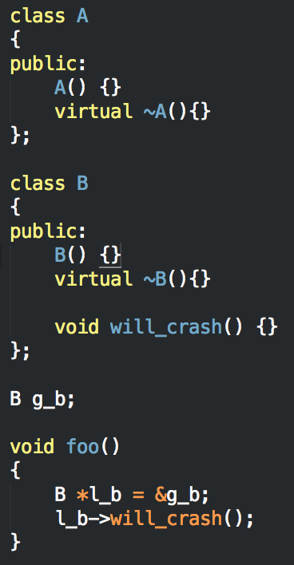
C++ Environment
ELF Loader
These _GLOBAL__sub functions handle more than just ctor / dtor logic, but also include some relocations.
For example, this code will crash if the _GLOBAL__sub_I_xxx function is not executed.
To support the execution of the ctors/dtors fucntions, Bareflank provides a custom C Runtime Library called bfcrt

Slide 38
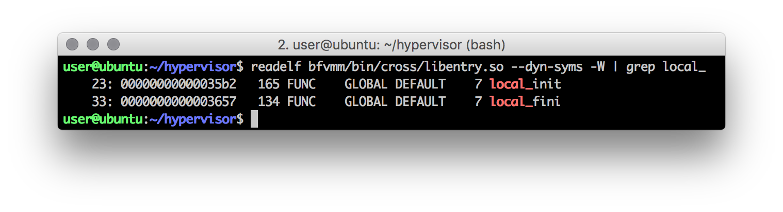
C++ Environment
C Runtime Library
The Bareflank C Runtime (bfcrt) provides two functions:
local_init
local_fini
This library is compiled as a static library and the GCC/G++ wrapper links this library with every shared library that it compiles and links

Slide 39
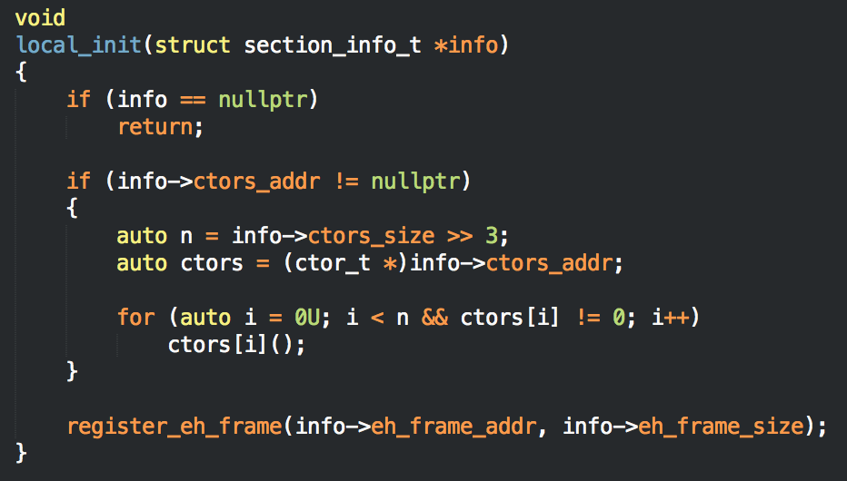
C++ Environment
C Runtime Library
Once each module is loaded and relocated using the ELF loader, each module’s local_init function is executed which runs the functions in the .ctor table

Slide 40
C++ Environment
ELF Loader
The ELF loader must also deal with weak / strong symbols.
Some libraries provide functions (symbols) while other libraries consume (i.e. use) functions from other libraries.
The ELF loader must locate each function and provide every library that uses that function with it’s address (this is part of the relocation process)

Slide 41
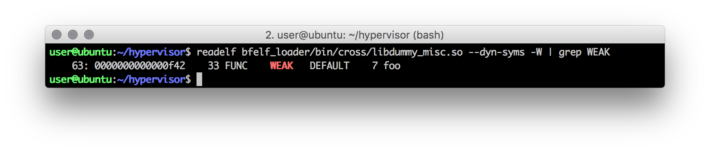
C++ Environment
ELF Loader
What if the same function is defined twice?
In our case, we pick the first symbol we find. To help with this problem, ELF provides “weak” symbol support.
Using __attribute__((weak)), GCC will mark a function as weak, telling the ELF loader to pick the strong symbol over the weak symbol

Slide 42
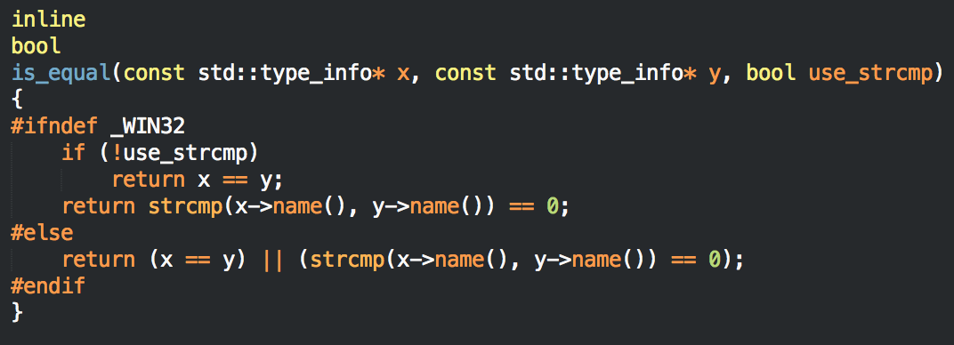
C++ Environment
ELF Loader
What if every symbol is defined weak? Turns out the Itanium C++ ABI states that if this happens, you must use the same symbol for references in all libraries.
The reason for this is GCC marks all std::type_info symbols as weak and dynamic_cast relies on this when it is doing it’s pointer comparisons.

Slide 43

C++ Environment
ELF Loader
https://llvm.org/bugs/show_bug.cgi?id=26785

Slide 44
C++ Environment
ELF Loader
ELF Loader Limitations:
Currently the ELF loader does not do Lazy Loading (for many reasons). For more information on what this is: http://eli.thegreenplace.net/2011/11/03/position-independent-code-pic-in-shared-libraries/
Currently the ELF loader can only loads shared libraries. There is no binary support. Future version of Bareflank will fix this
Since Bareflank only supports 64bit, it also requires position independent code (both –fpic and eventually –fpie)
Currently the ELF loader only supports Intel/AMD. Future versions of Bareflank will be adding ARM support

Slide 45
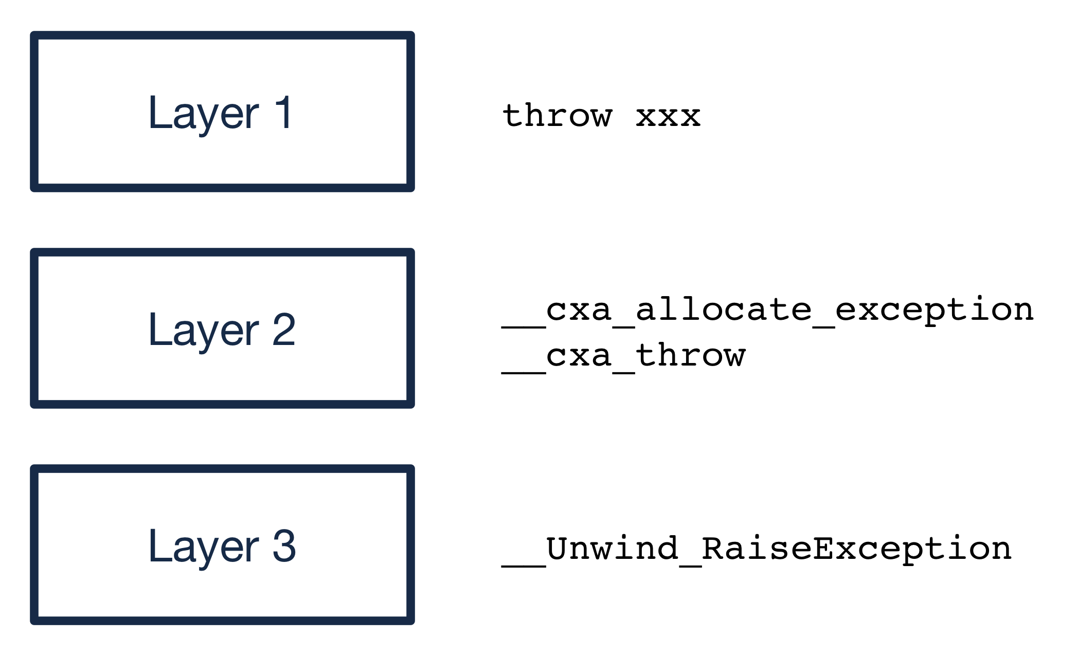
C++ Environment
Unwind Library
C++ exception support is provided by three layers:

Slide 46
C++ Environment
Unwind Library
Layer 1 is provided by the C++ compiler itself. When you call “throw xxx” the compiler compiles this into a set of assembly instructions which result in a call to:
__cxa_allocate_exception
__cxa_throw
These __cxa_xxx functions are provided by Layer 2, which in this case is the libc++abi library.
http://libcxxabi.llvm.org/spec.html

Slide 47
C++ Environment
Unwind Library
Layer 2 is architecture independent, yet C++ exceptions have to unwind the stack, which requires architectural knowledge.
To support this Layer 2 calls into Layer 3 functions, which on x86_64 is defined by the IA64 C++ ABI. https://mentorembedded.github.io/cxx-abi/abi.html
In this case, _Unwind_RaiseException is called which resides in the “unwind” library and actually performs the stack unwinding

Slide 48
C++ Environment
Unwind Library
Currently the three major libraries that provide Layer 3 support include:
Libgcc
Libunwind (Google)
Libunwind (Apple)
All three of these libraries are designed for user-space and thus rely on thread support, malloc/free, and various other libraries that are not available in our C++ environment
For these reasons, Bareflank provides a custom, kernel-safe, thread-safe unwind library

Slide 49
C++ Environment
Unwind Library
The unwind library relies on several specs to work:
DWARF4: http://www.dwarfstd.org/doc/DWARF4.pdf
LSB: https://refspecs.linuxfoundation.org/LSB_5.0.0/LSB-Core-generic/LSB-Core-generic.pdf
IA64 C++ Spec: https://mentorembedded.github.io/cxx-abi/abi.html
System V Spec: http://www.x86-64.org/documentation/abi.pdf
In addition to the documentation in these specs, each header file in Bareflank’s unwind library is named after the spec it uses, and documents how it is used.

Slide 50
C++ Environment
Unwind Library
The unwind library’s job is to reverse the function stack, cleaning up each function as it goes (including destroying locally created C++ objects)

Slide 51
C++ Environment
Unwind Library
The process starts in bfcrt, were a call is made to register the “.eh_frame” location and size with the unwinder.

Slide 52
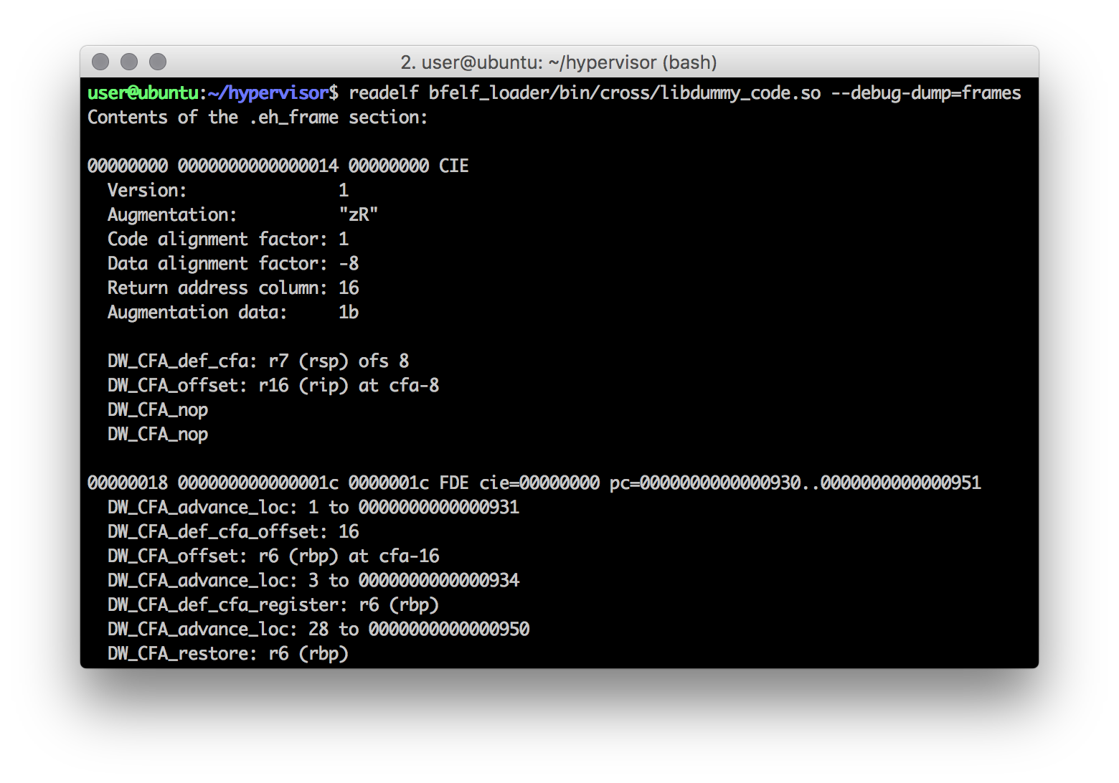
C++ Environment
Unwind Library (continued)
The format of the information in “.eh_frame” is defined by the LSB and DWARF4 specs. This section stores the instructions on how to undo each stack frame in the code in a DWARF4 compressed format.

Slide 53
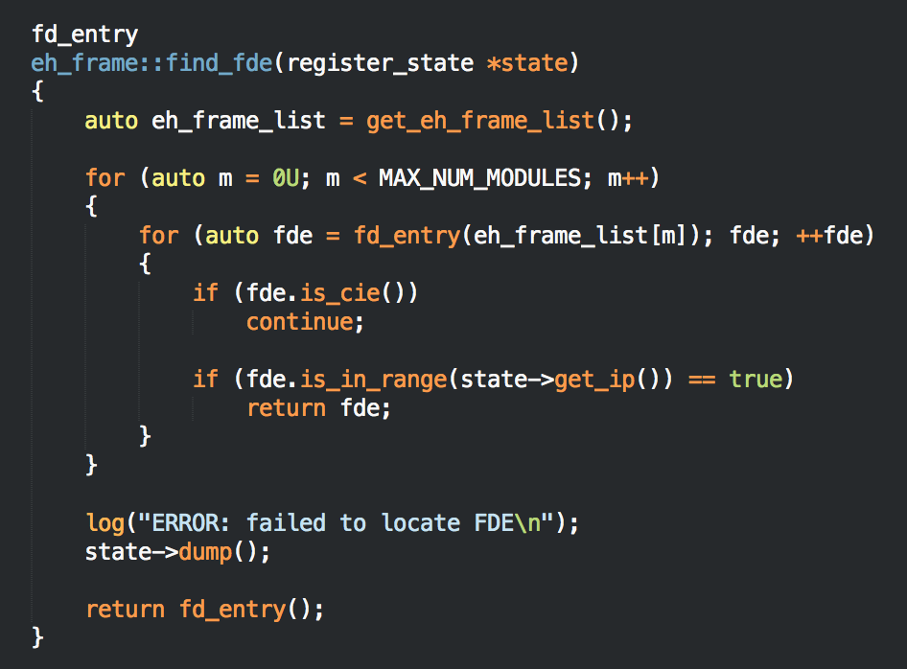
C++ Environment
Unwind Library (continued)
When an exception is thrown, the unwind library takes the current stack pointer and locates the stack frame information in “.eh_frame” for that pointer

Slide 54
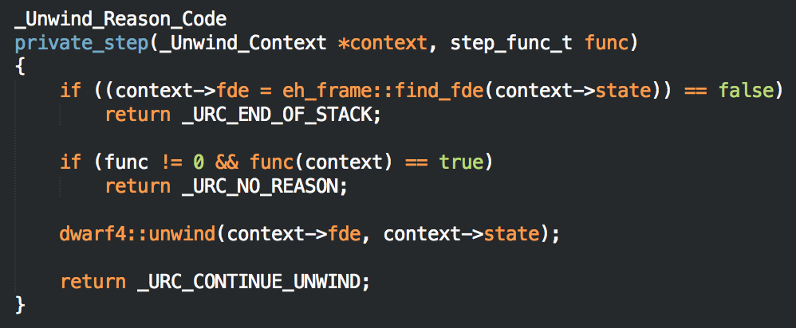
C++ Environment
Unwind Library (continued)
The unwind library uses this call frame information to unwind the stack, resulting in a new instruction pointer

Slide 55
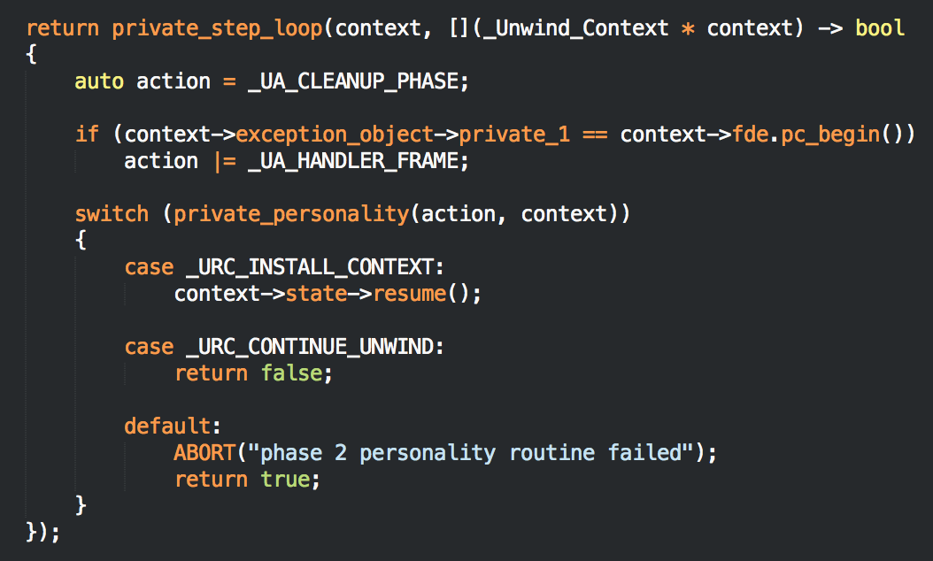
C++ Environment
Unwind Library (continued)
This process is repeated until the “personality” function tells the unwind library to stop and resume (usually from a catch or RAII destructor).

Slide 56
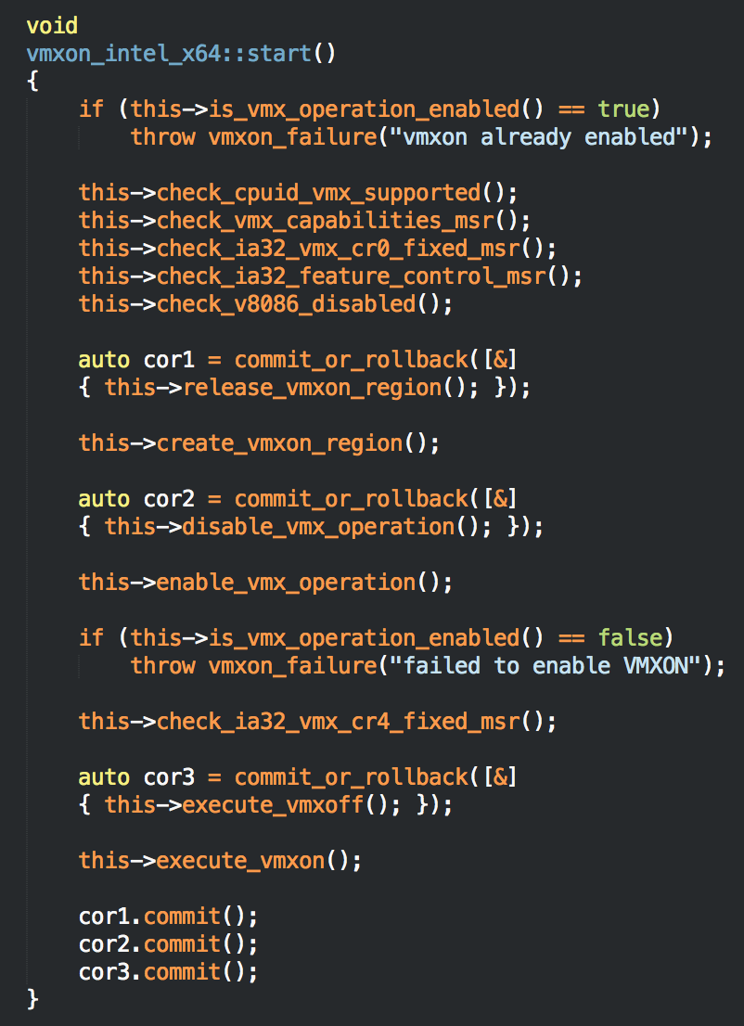
C++ Environment
Commit or Rollback
Bareflank also provides a “commit or rollback” class that can be used to undo state changes (instead of using goto).
Simply define an instance of the class and provide the rollback code.
If commit is not called, when the instance is destroyed, the rollback code is called

Slide 57
C++ Environment
Limitations
There are some limitations with Bareflank’s C++ environment:
There is no support for libc. This library only exists to support libc++ and future versions of Bareflank are likely to continue to remove libc functions over time
Not all C++ STL functionality is supported (e.g. fstream). Future versions will provide a unit test for C++ itself that will clearly define what is supported
Currently some C++ functionality is missing (e.g. unordered_map). Future versions will patch libc++ to provide this missing functionality
Support for C++14 / C++17 depends on the compiler you use (i.e. GCC 6.1 is needed for complete C++14 support)

Slide 58

Break

Slide 59
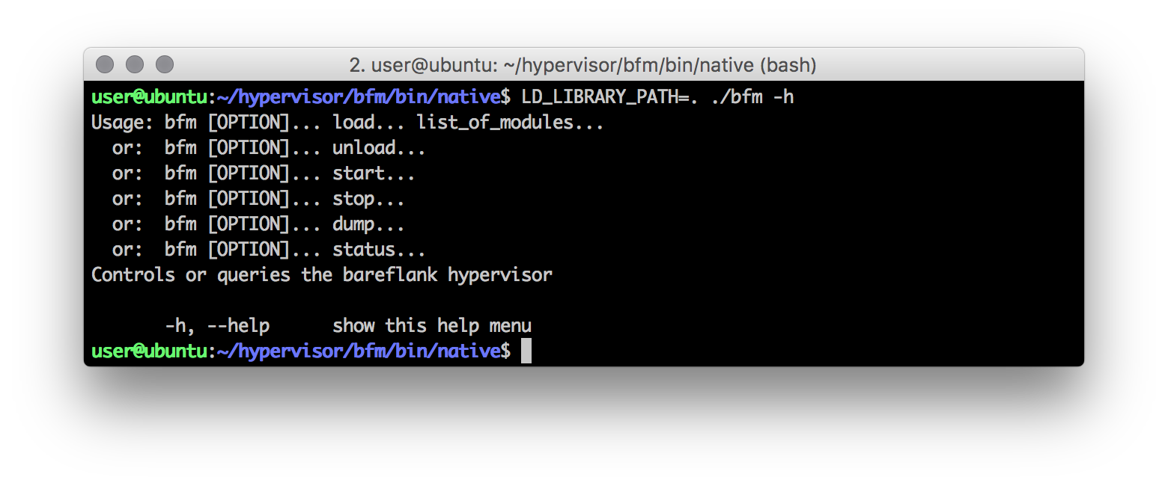
Bareflank Manager
The Bareflank Manager (BFM) is a user-space application that is used to control the hypervisor

Slide 60
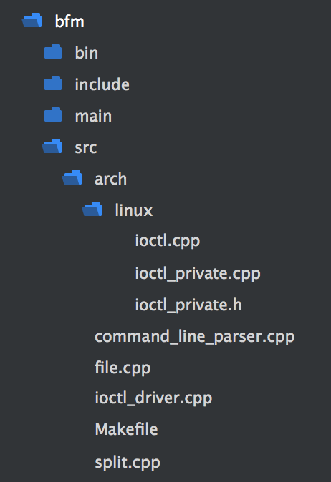
Bareflank Manager
Requirements
BFM is written only using the C++11 / C++ 14 STL, which means it will compile on most operating systems (i.e. Linux, Windows and OS X)
To support each OS, the IOCTL interface has been abstracted allowing each OS to provide it’s own IOCTL implementation

Slide 61
Bareflank Manager
Commands
BFM currently supports the following commands:
load: given a list of modules, loads the modules into the kernel
unload: removes previously loaded modules from the kernel
start: once loaded, starts the hypervisor
stop: once started, stops the hypervisor
dump: prints the contents of the debug_ring to the terminal
status: get’s the status of the hypervisor
In addition to running BFM manually, the root Makefile for Bareflank provides shortcuts to run these commands

Slide 62
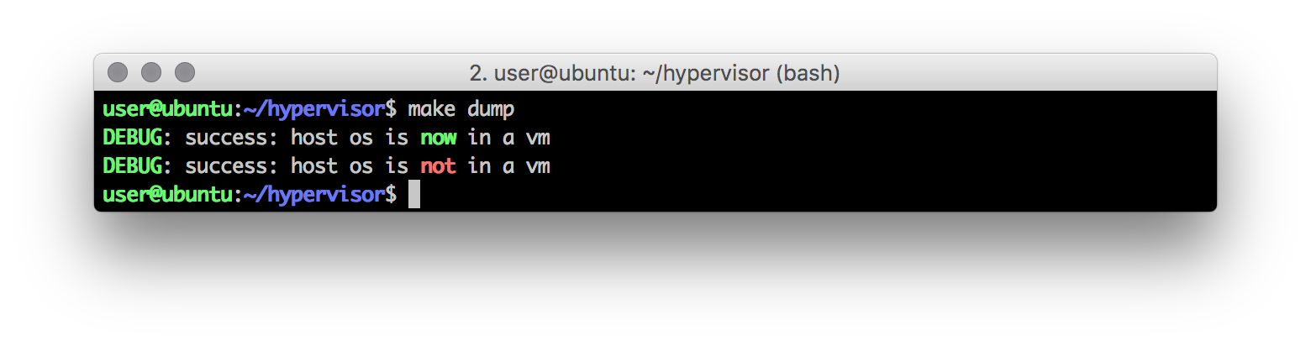
Bareflank Manager
Limitations
BFM currently does not have a way to extend it with additional commands, but future versions will fix this issue.
Running the “dump” command will show what is sent to std::cout and std::cerr except in any constructor / destructor tied to the vCPU class due to the fact that the debug_ring is being created / destroyed at the same time. To get this out, use serial

Slide 63
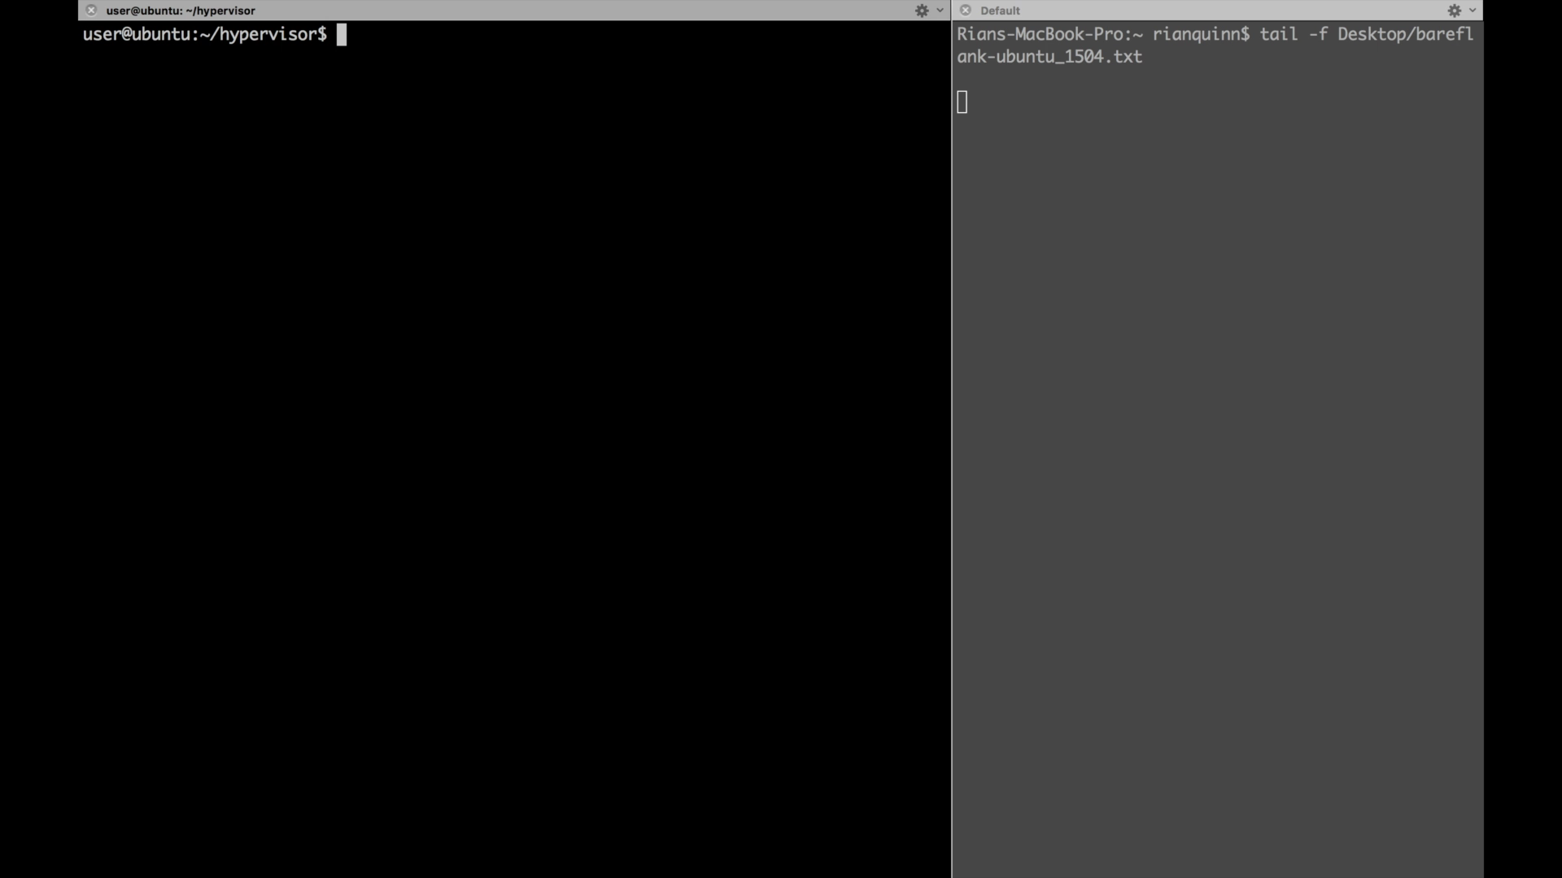
Bareflank Manager
Demo

Slide 64
Drivers
High Level Architecture
Driver entry functions needed by the OS. Each entry function calls the common code
Platform specific functionality needed by the common code
Used by the common code to load the VMM’s ELF modules
Cross platform, core business logic that manages the VMM

Slide 65
Drivers
High Level Architecture
The Bareflank Drivers (also known as entry points) are designed to be as small as possible.
Their sole job is to use the ELF loader to load and execute the VMM
To support this, they have the ELF loader, entry, common and platform specific code

Slide 66
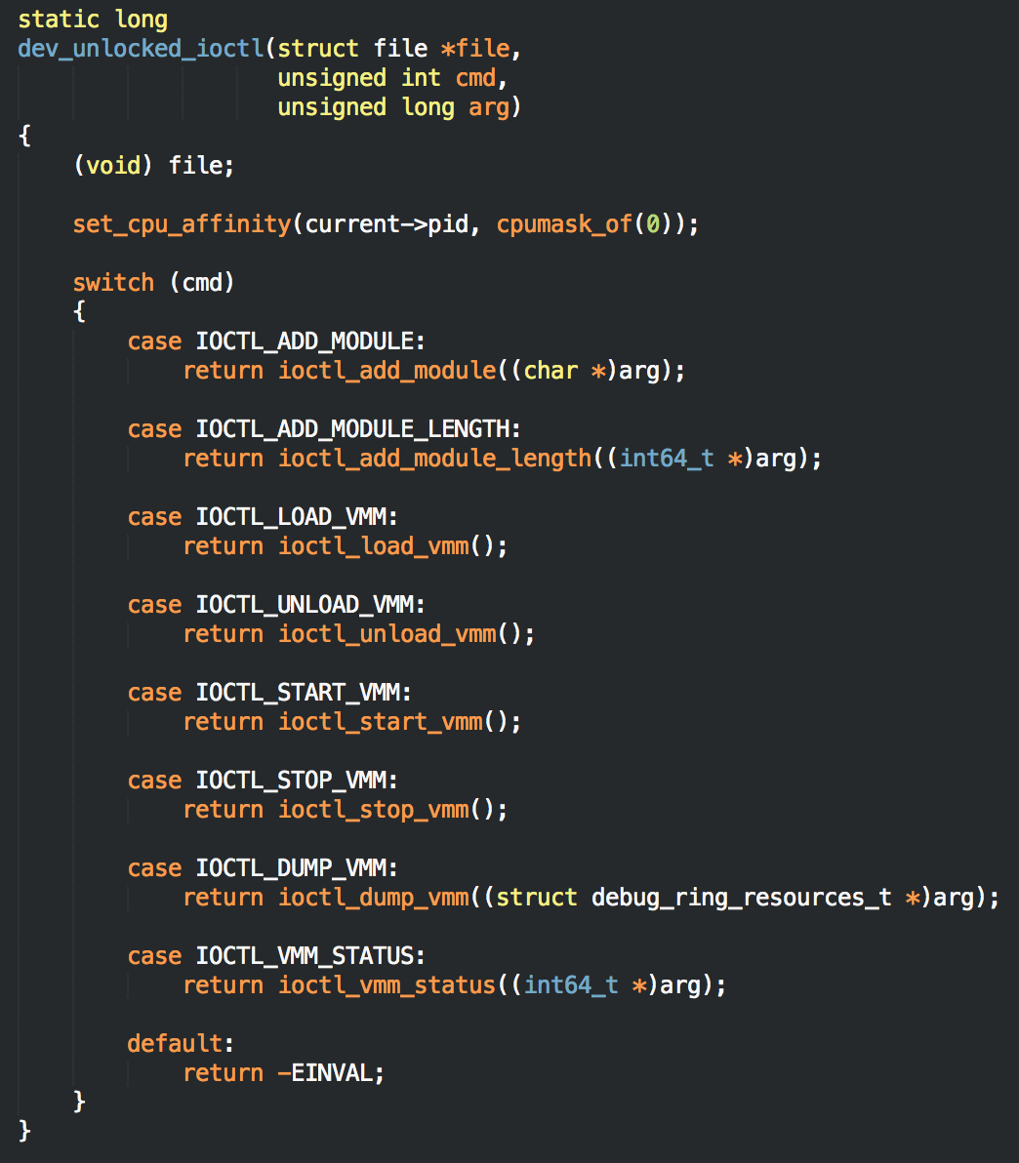
Drivers
Entry
When BFM issues a command, it does so by communicating with the driver’s IOCTL interface
The driver entry code in turns calls in to the common code to execute the VMM using the ELF loader

Slide 67
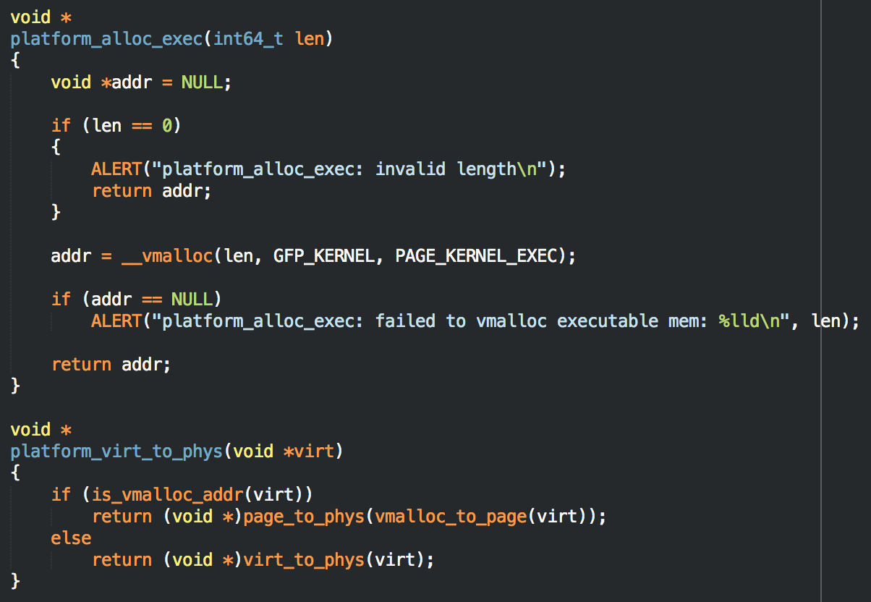
Drivers
Platform
Since the common code is cross platform, platform code was added for platform specific functions

Slide 68
Drivers
Issues
Bareflank only supports single core (to be addressed in the next version). Since BFM can be executed on any core, the driver must ensure it’s always running on the same core. To do this, we added
In addition, the VMM uses BFM’s set of pages tables (also to be addressed in the next version). To prevent these pages from being removed, we did this:

Slide 69
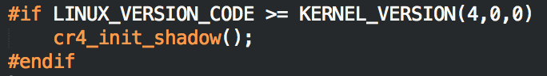
Drivers
Issues
Linux added with 4.0+ a new CR4 caching scheme that caused a lot of problems with virtualization: https://lkml.org/lkml/2014/10/14/474
The solution to this problem is the common code must refresh the CR4 shadow once CR4 has been changed.
If this is not done, when Linux performs a TLB flush a general protection fault will occur because Linux will attempt to disable VMX from non-root.

Slide 70
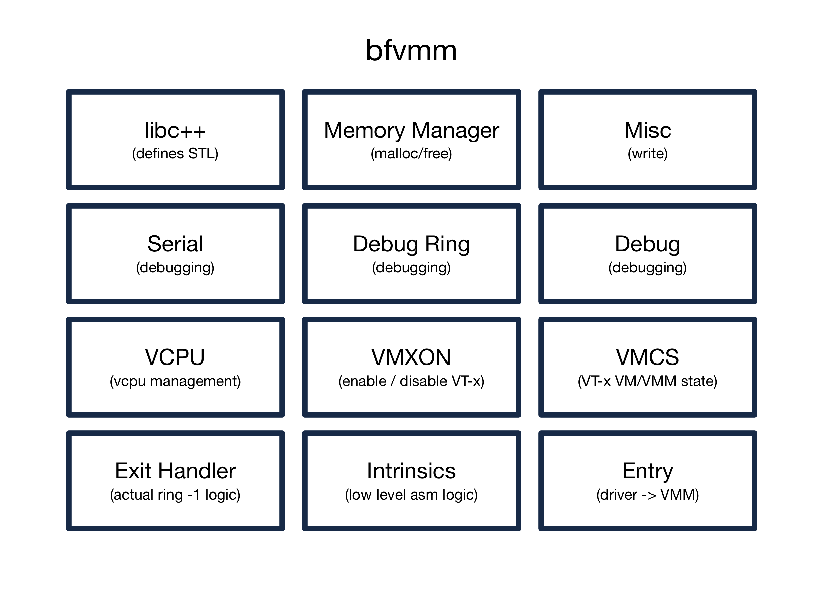
VMM
Module Overview
The Virtual Machine Monitor (VMM) is made up of the following modules:

Slide 71
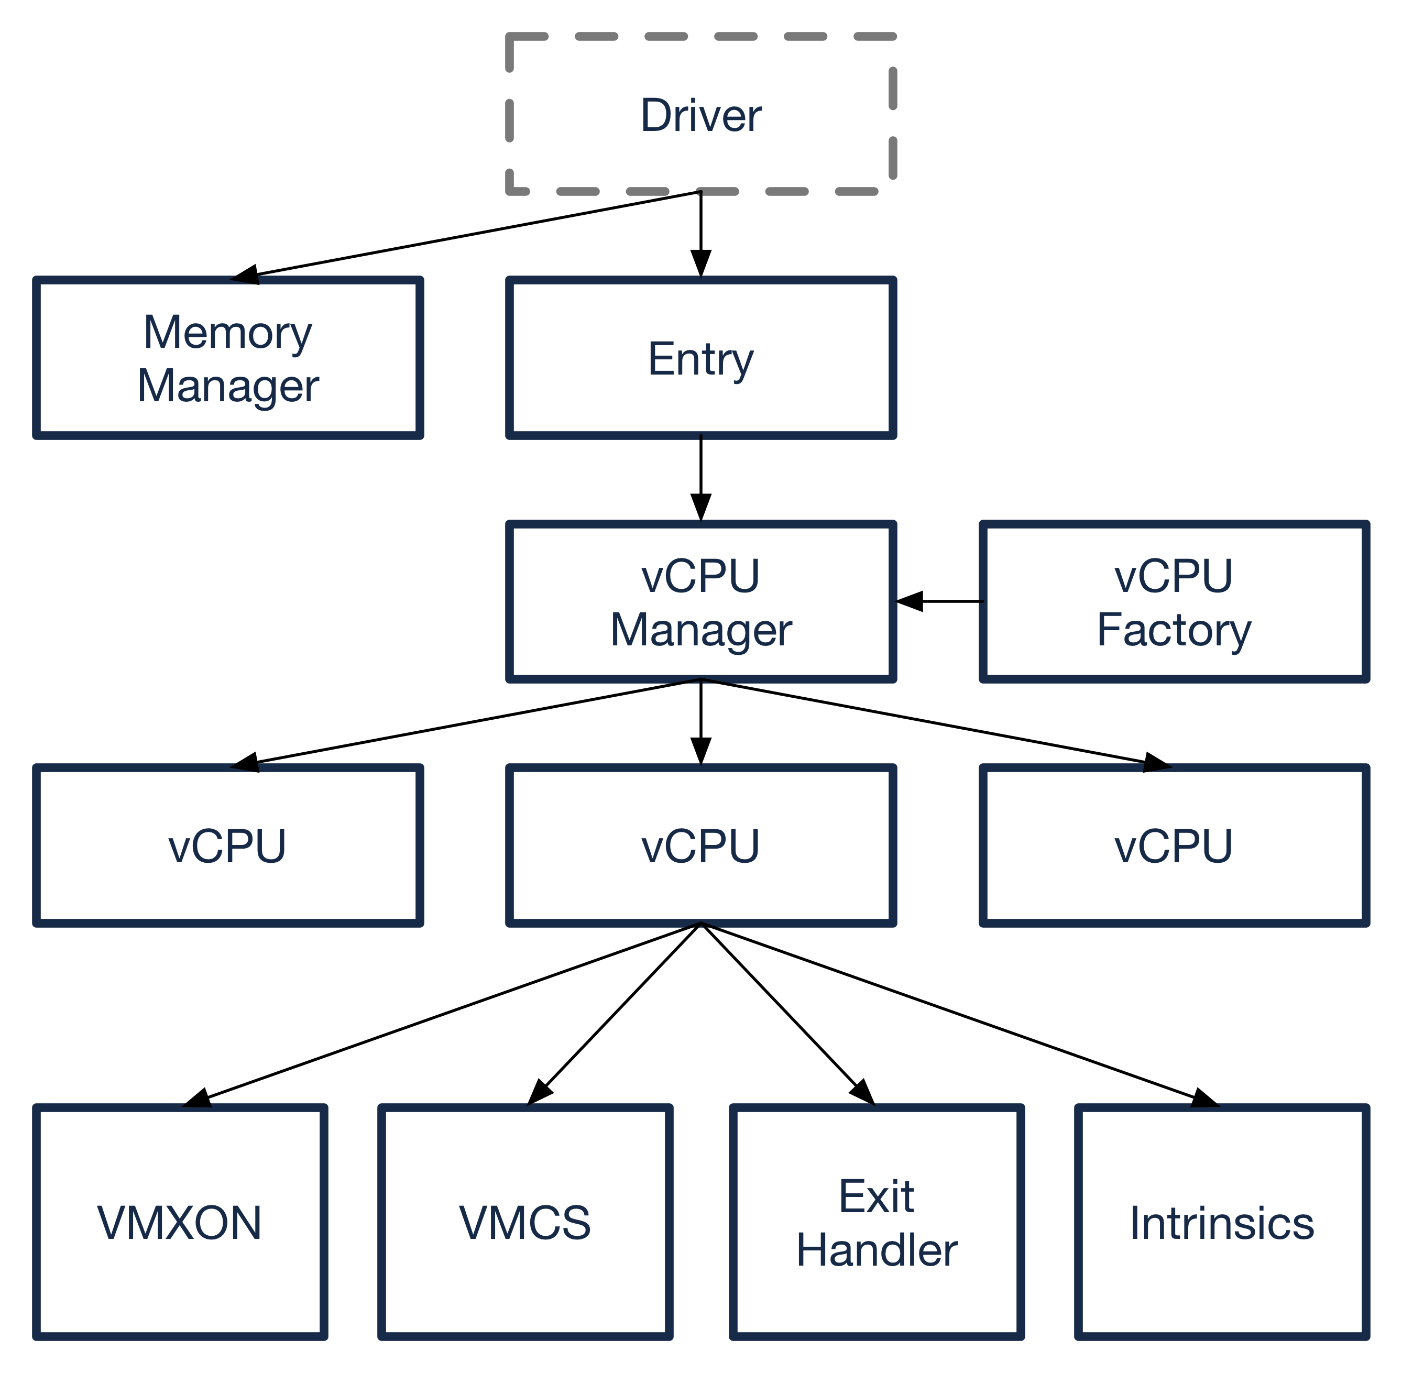
VMM
Module Organization

Slide 72
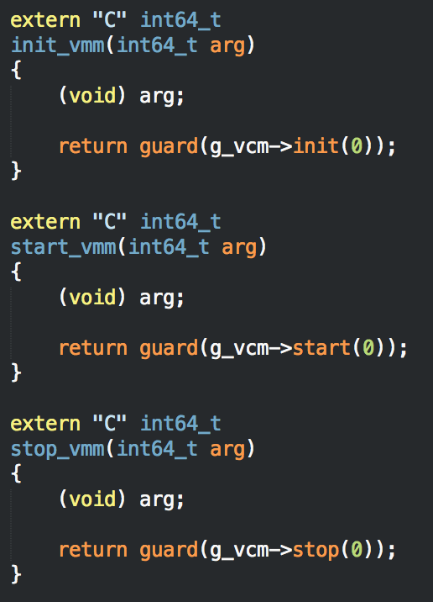
VMM
Entry Module
The entry code is called by the Bareflank driver to init, start and stop the VMM
There are other functions that are called by the driver including the get_drr and add_mdl functions.
In addition, the driver calls bfcrt’s local_init and local_fini functions

Slide 73
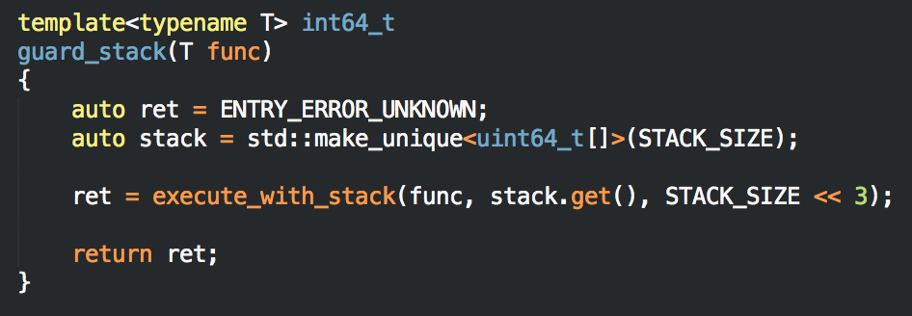
VMM
Entry Module
The “guard” macro not only catches all exceptions prior to returning to the driver, it also provides a custom stack
This ensures that libc++ does not overrun the kernel stack. This could cause a kernel oops if CONFIG_DEBUG_STACKOVERFLOW is enabled

Slide 74
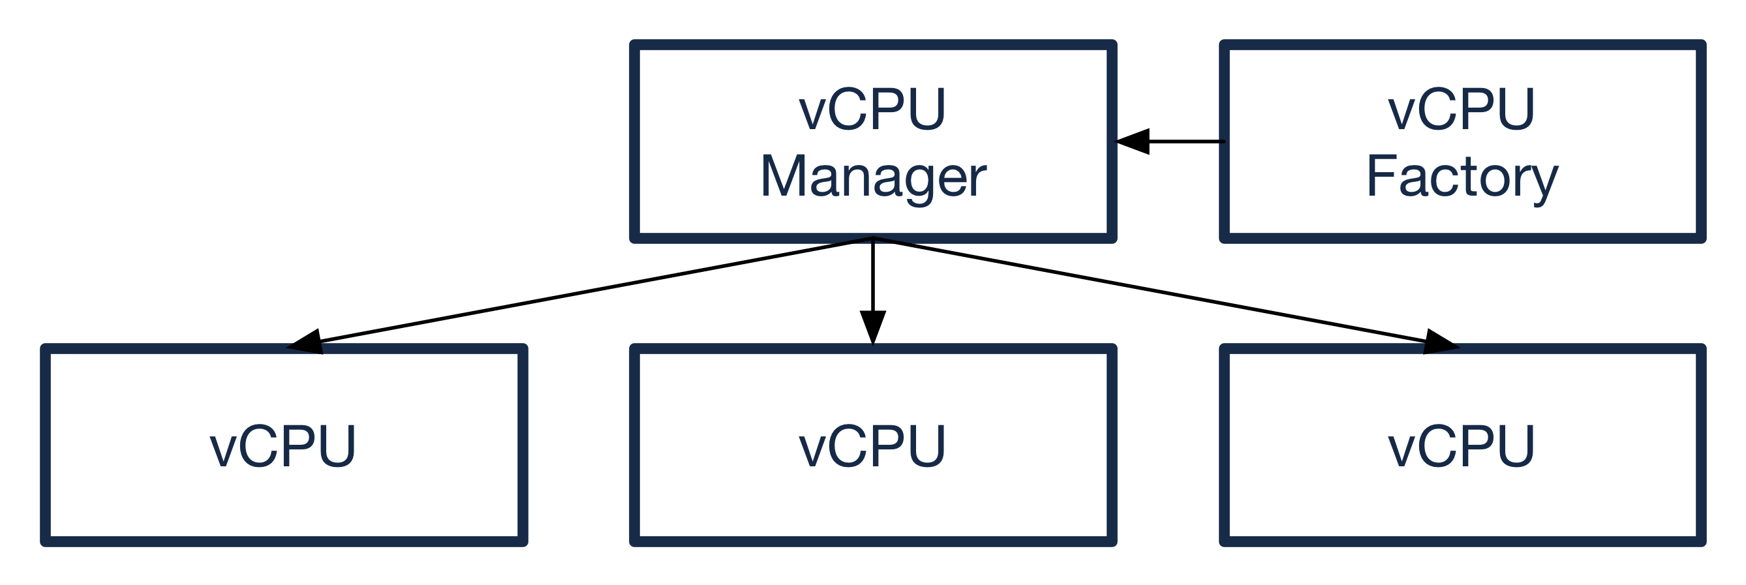
VMM
VCPU Module
A vCPU represents the resources needed to run the hypervisor on a physical CPU. The vCPU manager creates / destroys vCPUs using the vCPU factory
The vCPU module provides the base vCPU class as well as an Intel specific vCPU subclass that provides the VT-x logic for running the hypervisor

Slide 75
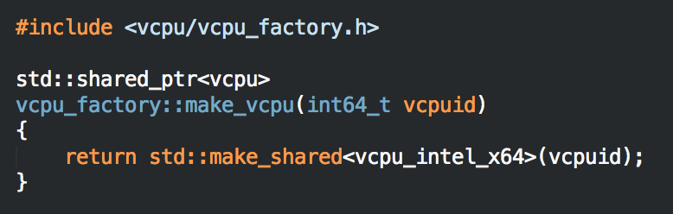
VMM
VCPU Module
The vCPU factory does nothing more than creates vCPUs. It’s in it’s own module providing a convenient “seem” for extending the hypervisor with custom vCPUs
This seem is also used to assist in unit testing the vCPU logic

Slide 76
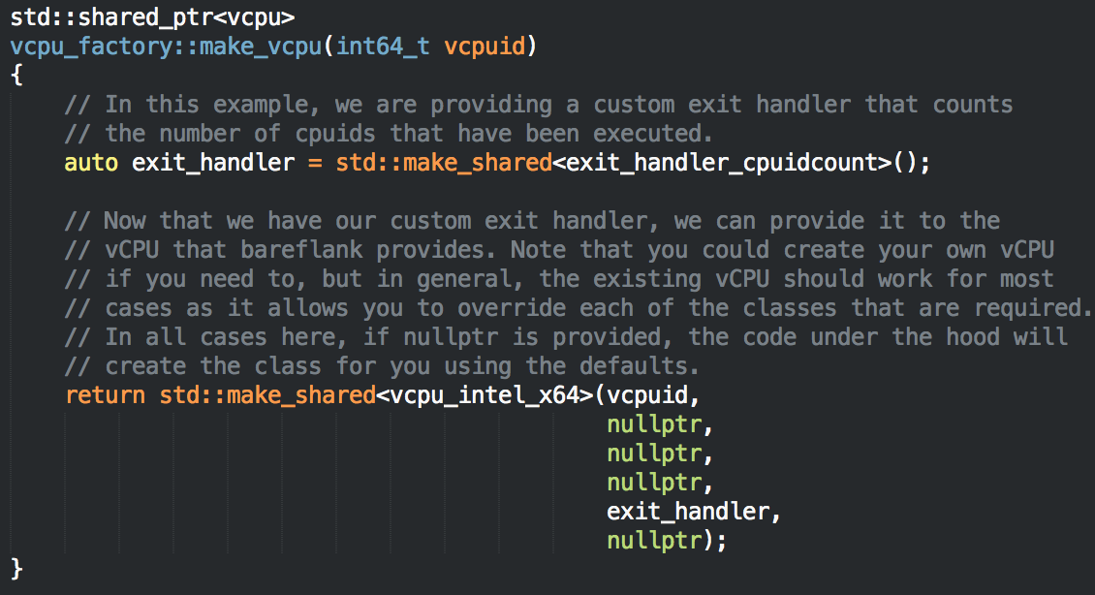
VMM
VCPU Module
When creating an Intel based vCPU you can either provide each resource yourself, or provide “nullptr” in which case the resource will be created for you.

Slide 77
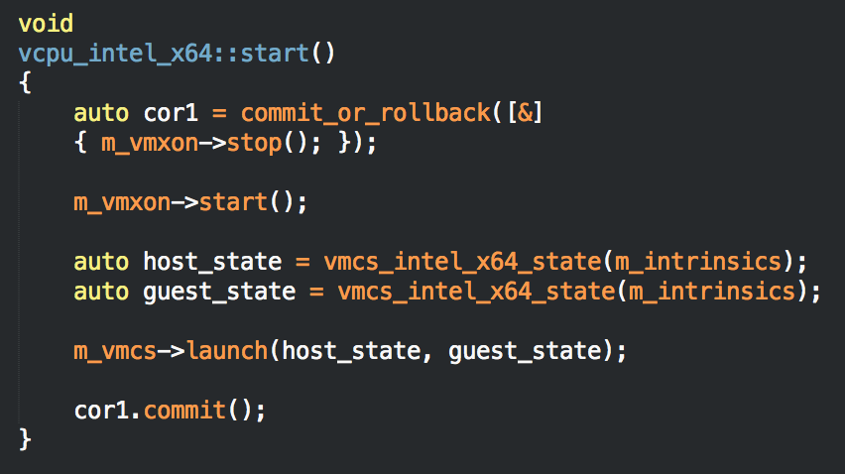
VMM
VCPU Module
Currently, the Intel based vCPU can only place the Host OS in a virtual machine (i.e. Host-Only Hypervisor). Future versions of Bareflank will address this.
As shown above, Bareflank uses Host OS’s resources like the GDT, IDT and Page Tables. Version 1.1 will address this.

Slide 78
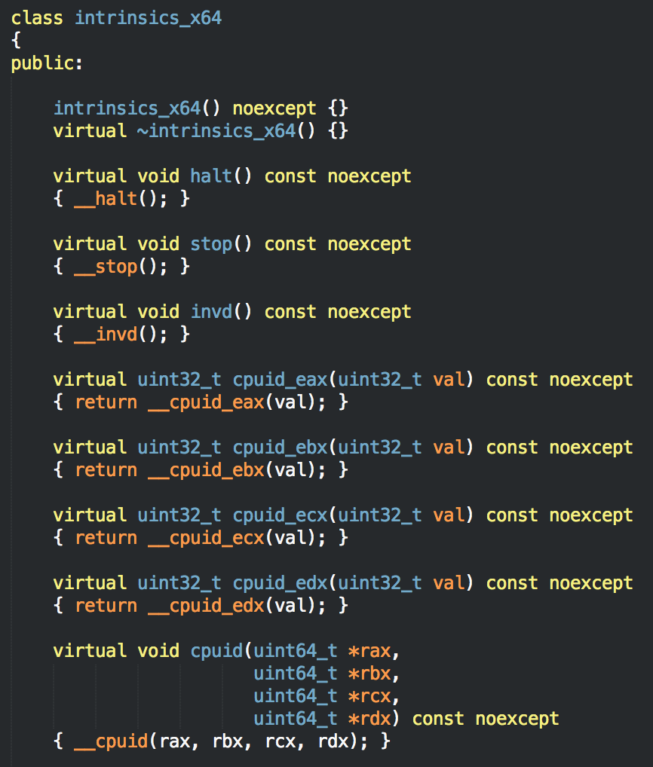
VMM
Intrinsics
The Intrinsics module provides calls to raw CPU instructions
Each intrinsic is wrapped in the C++ class providing the unit tests with a “seem” to mock the physical hardware to fake error conditions

Slide 79
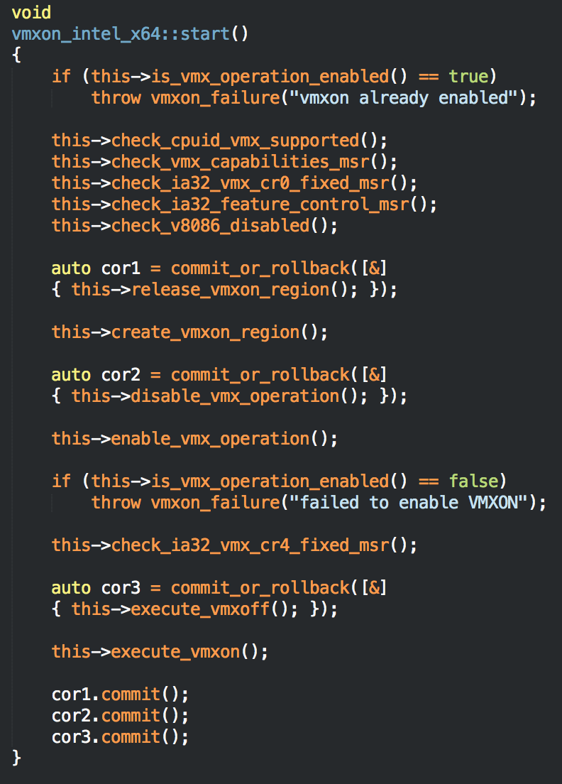
VMM
VMXON Module
Used by the Intel based vCPU, this module enables / disables VT-x.
The process used to turn on VT-x is documented in the Intel Software Developer’s manual, section 31.5

Slide 80

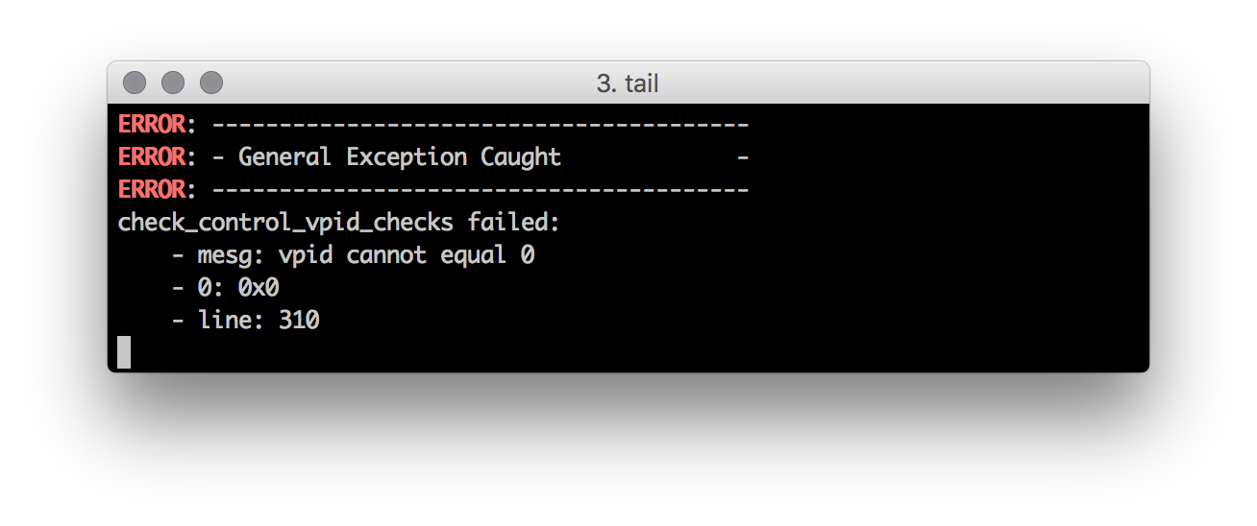
VMM
VMCS Module
The Virtual Machine Control Structure module is used by the Intel based vCPU to create and launch a VM as well as promote a VM to root operation (i.e. stop the hypervisor).
The VMCS also implements the failure checks defined in chapter 26 (all of them… )

Slide 81

VMM
VMCS Module
Although the VMCS failure checks are implemented, the unit tests for these checks are not complete due to their insane complexity. This will be resolved in future versions.

Slide 82
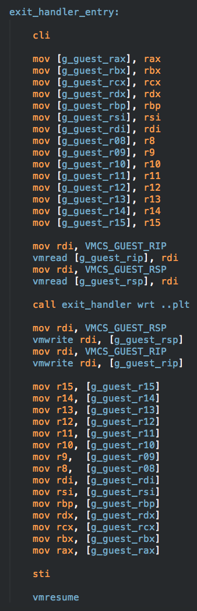
VMM
Exit Handler Module
The exit handler is the actual code that is run in so called “ring -1”. This code needs to run as fast as possible as it’s emulating whatever instruction cause an exit.
This first thing the exit handler does when an exit occurs is it saves the state of the guest so that it can be restored on resume
At the moment this code only works on a single core, which will be addressed in version 1.1

Slide 83
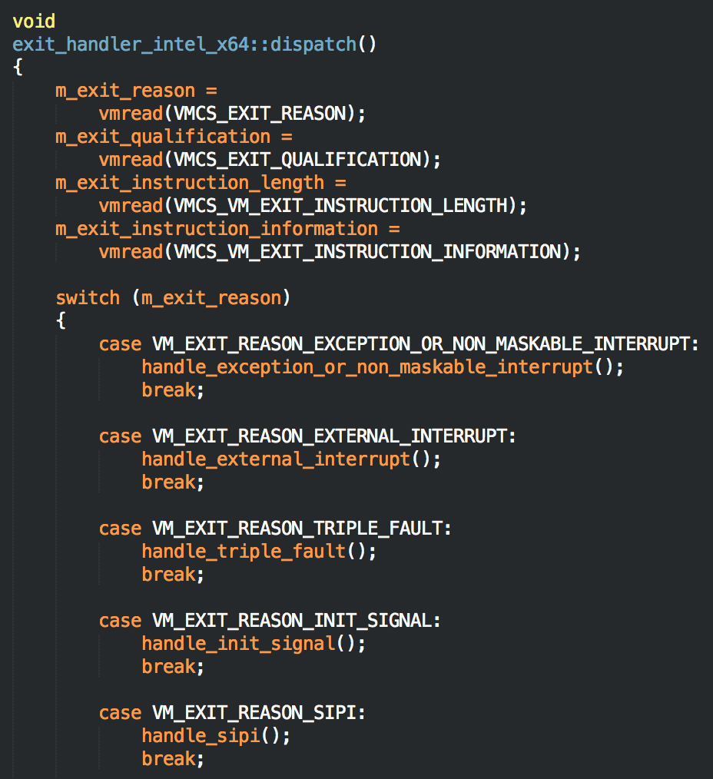
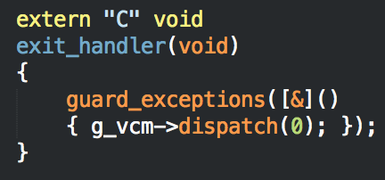
VMM
Exit Handler Module
The asm code calls a C trampoline into a C++ exit handler that performs the dispatch
From there the exit is handled based on what type of exit occurred

Slide 84
VMM
Memory Manager Module
The memory manager implements malloc, free, virt_to_phys and phys_to_virt.
Memory management is done using a pool of memory located in the .BSS section of the memory manager’s module. Memory is divided up using a reliable, yet wasteful first fit algorithm. Future versions might optimize this.
The smallest chunk of memory that can be allocated is 64 bytes (cache line), and memory can be allocated with a specific alignment by calling the memory manager directly

Slide 85

VMM
Memory Manager Module (continued)
To handle virt_to_phys and vice versa, the driver calls add_mdl with the virt / phys information needed to perform the translations prior to starting the VMM.
Using a forward and reverse lookup set of maps, the memory manager can perform the translations needed.

Slide 86
VMM
Misc Module
The misc module provides the “write” and “fstat” functions which are called by libc++.
fstat is ignored and always returns an error (which libc++ seems to be ok with)
write is used by iostream for std::cout and std::cerr. As a result, if the file handles match STDOUT and STDERR, the write function dumps the resulting string to the serial device and to the vcpu manager.
Future versions will allow iostream to write to a special set of file descriptors that will id a specific core for debugging issues with a single core

Slide 87
VMM
Serial Module
The serial module provides access to the serial devices for debugging (write only)
At the moment, the serial device does not support interrupts
To change the settings of the serial code, set the following prior to compilation:
DEFAULT_COM_PORT=COM1_PORT
DEFAULT_BAUD_RATE=baud_rate_115200
DEFAULT_DATA_BITS=char_length_8
DEFAULT_STOP_BITS=stop_bits_1
DEFAULT_PARITY_BITS=parity_none

Slide 88
VMM
Debug Ring Module
The debug ring module is similar to the serial module, but places each string into a circular buffer that can be read by the drivers.
Each vCPU gets it’s own debug ring, providing a means to have per-core debug messages in the future (something that is not implemented yet)
Although the debug ring provides access to debug information without a serial device, they are not available while the vCPU is being created or destroyed so some debug messages might get lost

Slide 89

VMM
Debug Header
In addition to std::cout and std::cerr, a debug.h was created that provides shortcuts for displaying different types of messages with color coding
The std::endl shortcut was also added as a means to change the line endings from “\n” to “\r\n” if needed

Slide 90
Unit Tests
A large percent of the code has a set of unit tests associated with it, or can be unit tested in future versions.
The unit test framework for Bareflank is simple, and defined in ”unittest.h”.
Mocking is done using Hippomocks: http://hippomocks.com
The Bareflank API documentation documents how to create your own unit tests using this framework. The best starting point is to grab an existing one and tailor it to your own code.

Slide 91

Break

Slide 92
Extending the VMM
Examples
Currently there are three examples of how to extend the hypervisor. Only two of these examples support Bareflank version 1.0:
https://github.com/Bareflank/hypervisor_example_vpid
https://github.com/Bareflank/hypervisor_example_cpuidcount
In Bareflank 1.0, only in-tree compilation is supported. To compile an extension, it’s directory must have either “hypervisor_xxx” or “src_xxx” as the name. Future versions will remove this limitation as well as provide out-of-tree compilation

Slide 93
Extending the VMM
Demo
Walk through VPID example

Slide 94
Extending the VMM
Demo
Walk through CPUID Count example

Slide 95
Future
Windows / OS X / UEFI Host Support
Multi-Core Support
Isolated VMM
VT-x Extended APIs
Updated C++ Environment
ARM / AMD Support
Nested Virtualization Support
Guest Support / Hyperkernel (Linux guests for now)
PV driver interfaces (shared mem, events, etc…)
BFM Qt Based GUI

Slide 96

Questions

